Slide 1

Church, Now Is the Time :
“Returning to Our Roots”

Slide 2


Slide 3


Slide 4
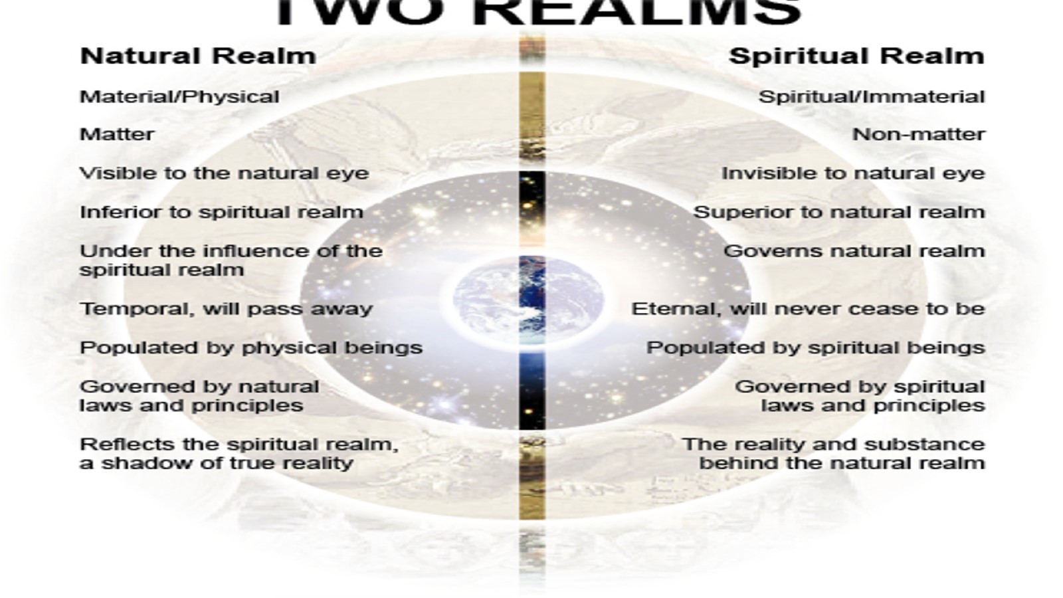

Slide 5

A Supernatural or A Spiritual Perspective

Slide 6
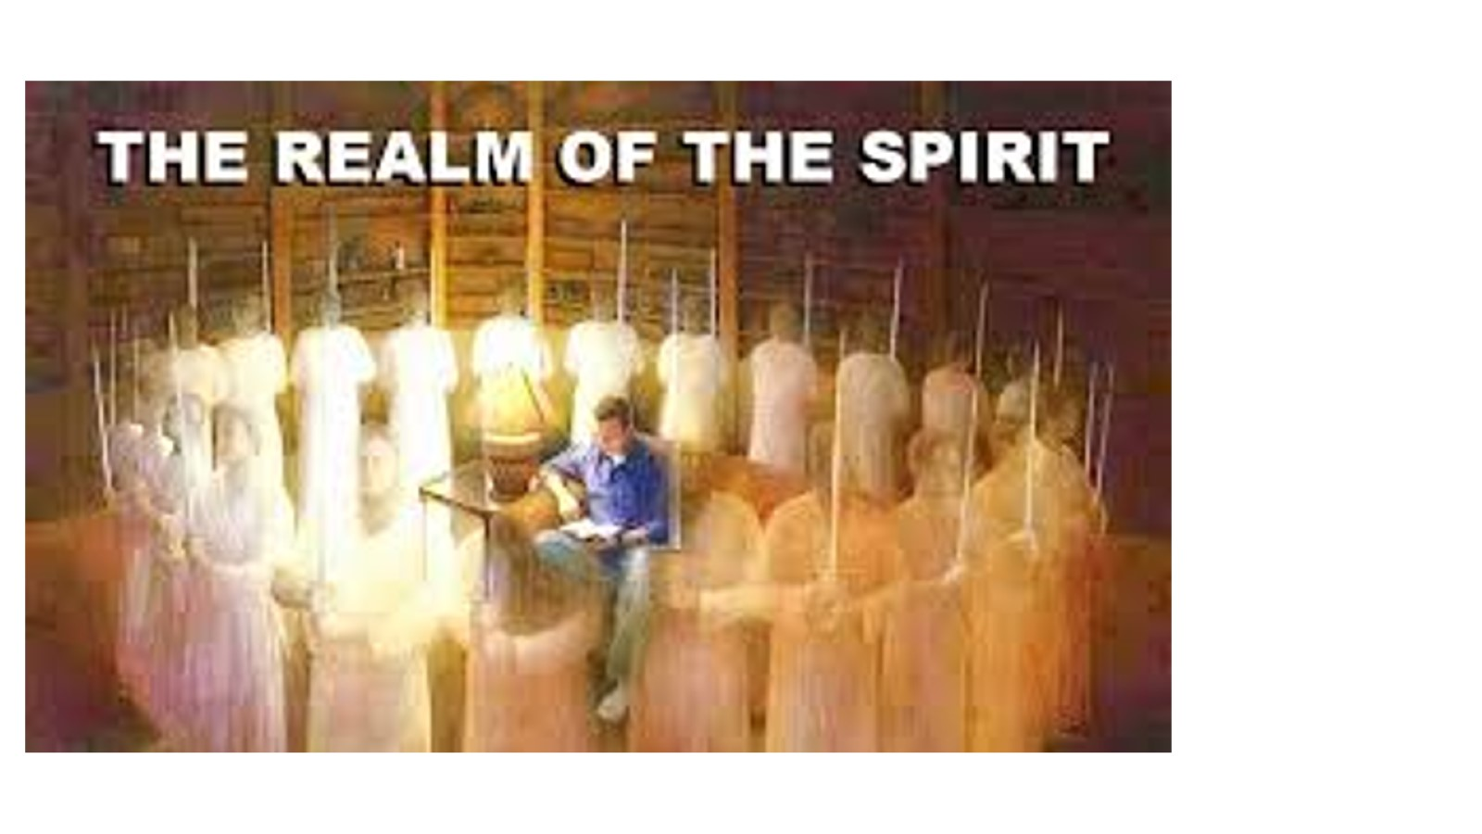

Slide 7
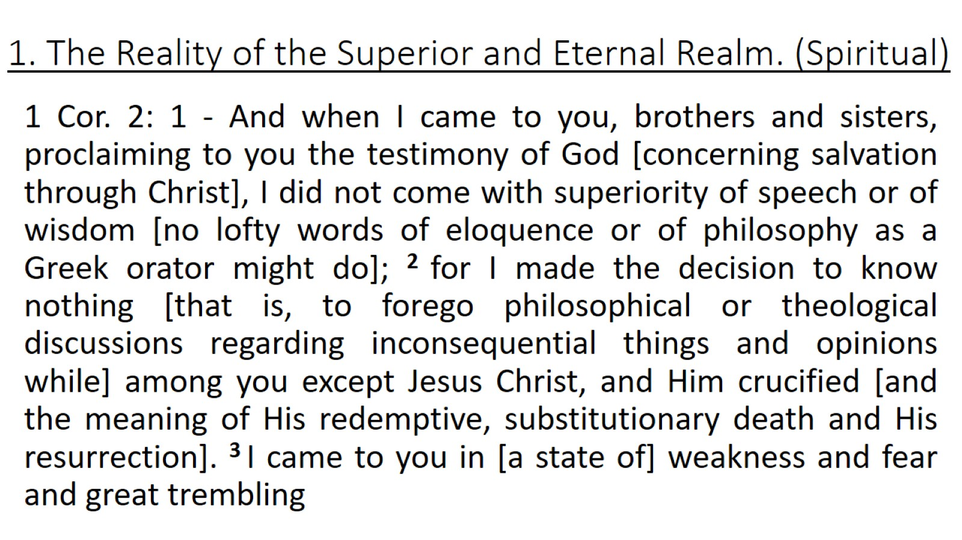
1. The Reality of the Superior and Eternal Realm. (Spiritual)

Slide 8
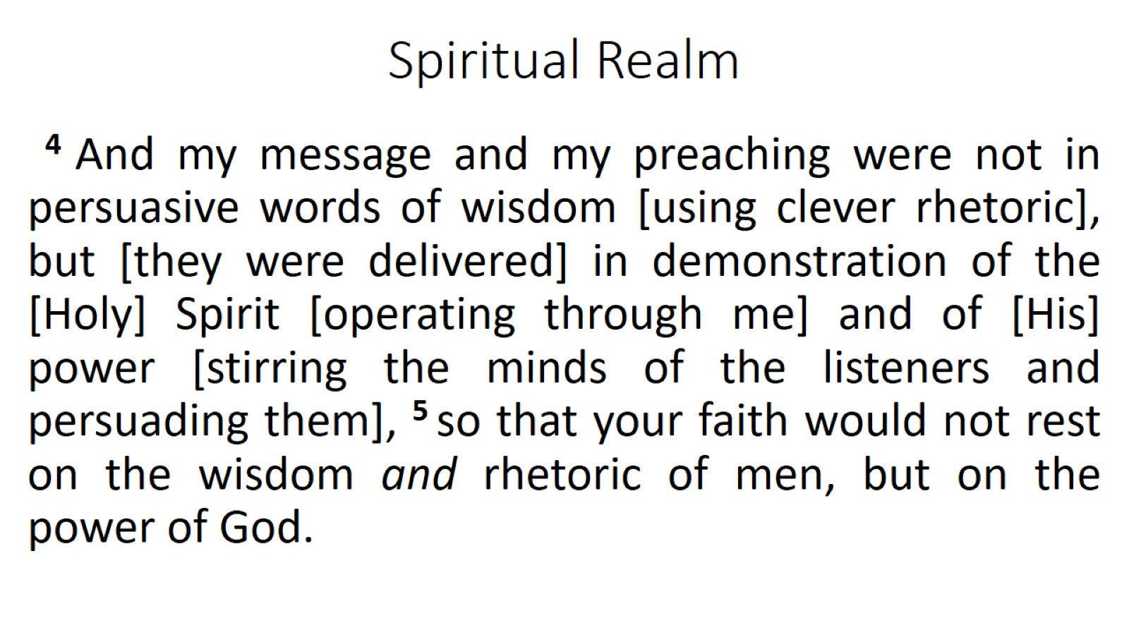
Spiritual Realm

Slide 9
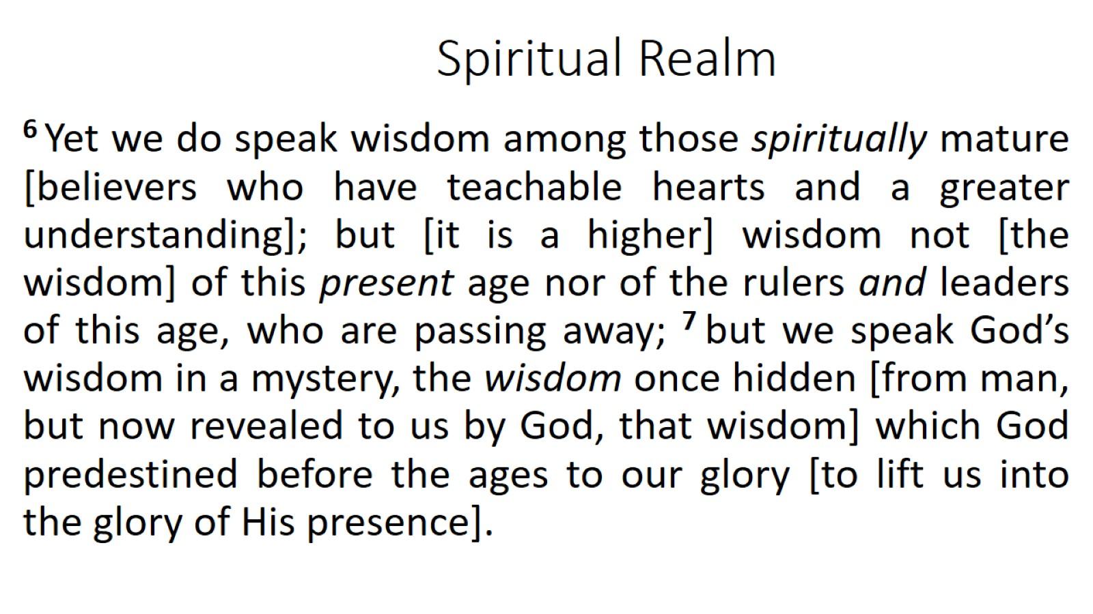
Spiritual Realm

Slide 10
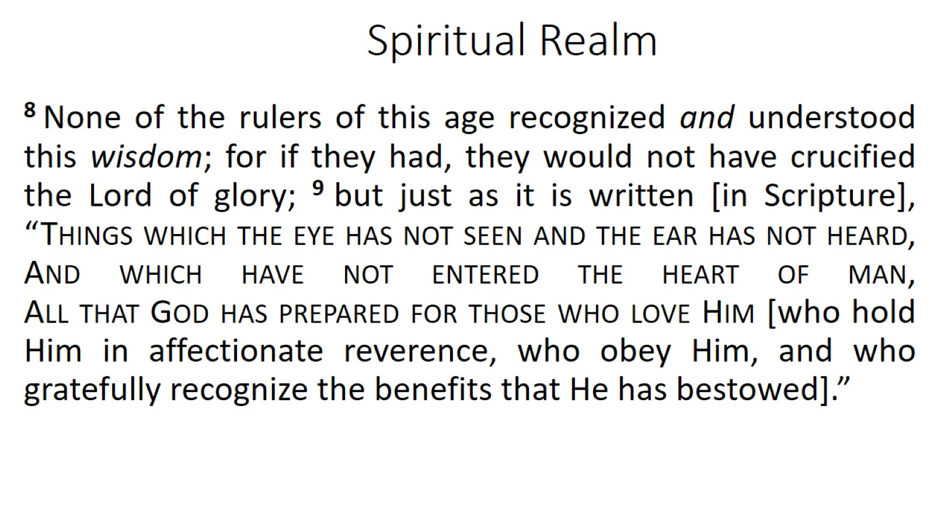
Spiritual Realm

Slide 11
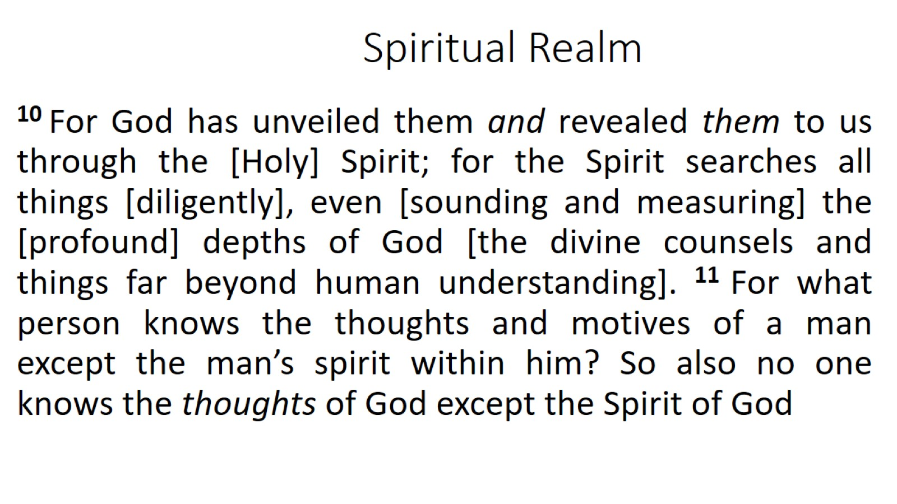
Spiritual Realm

Slide 12
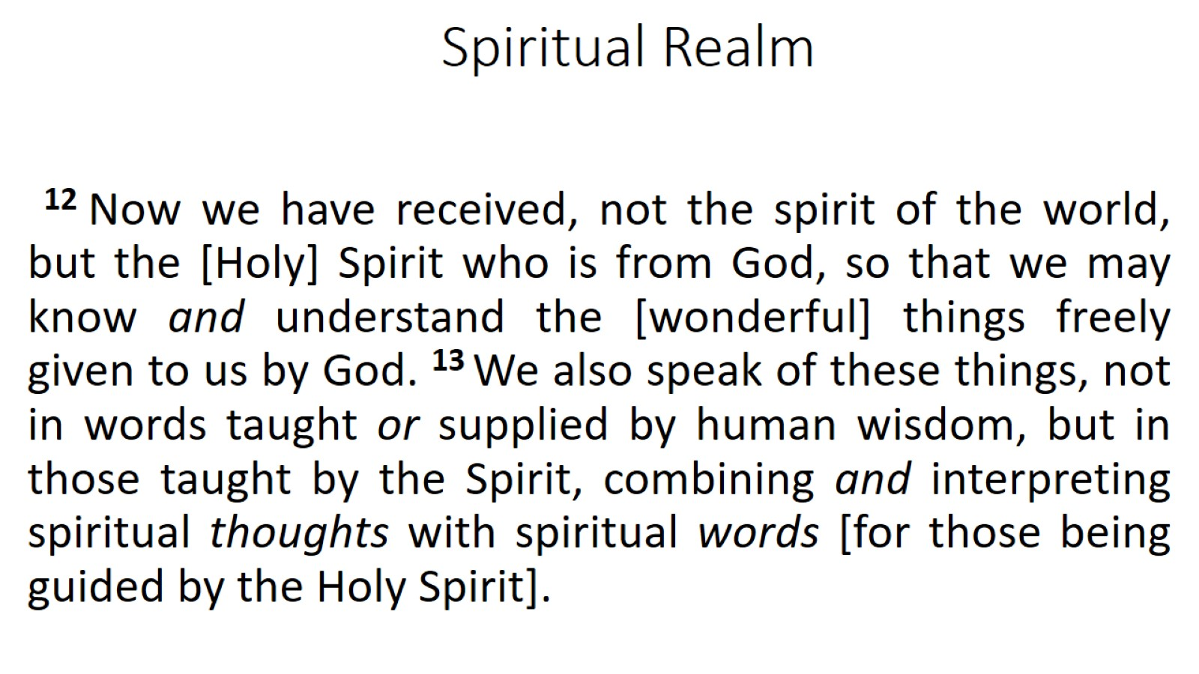
Spiritual Realm

Slide 13
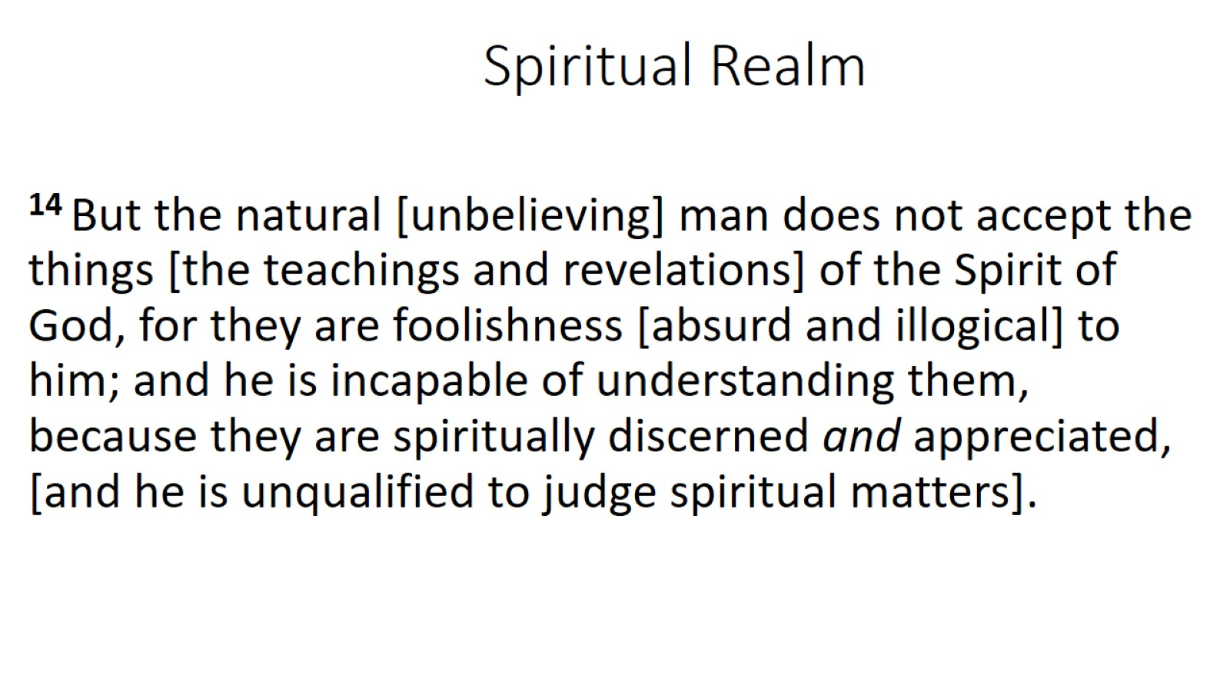
Spiritual Realm

Slide 14
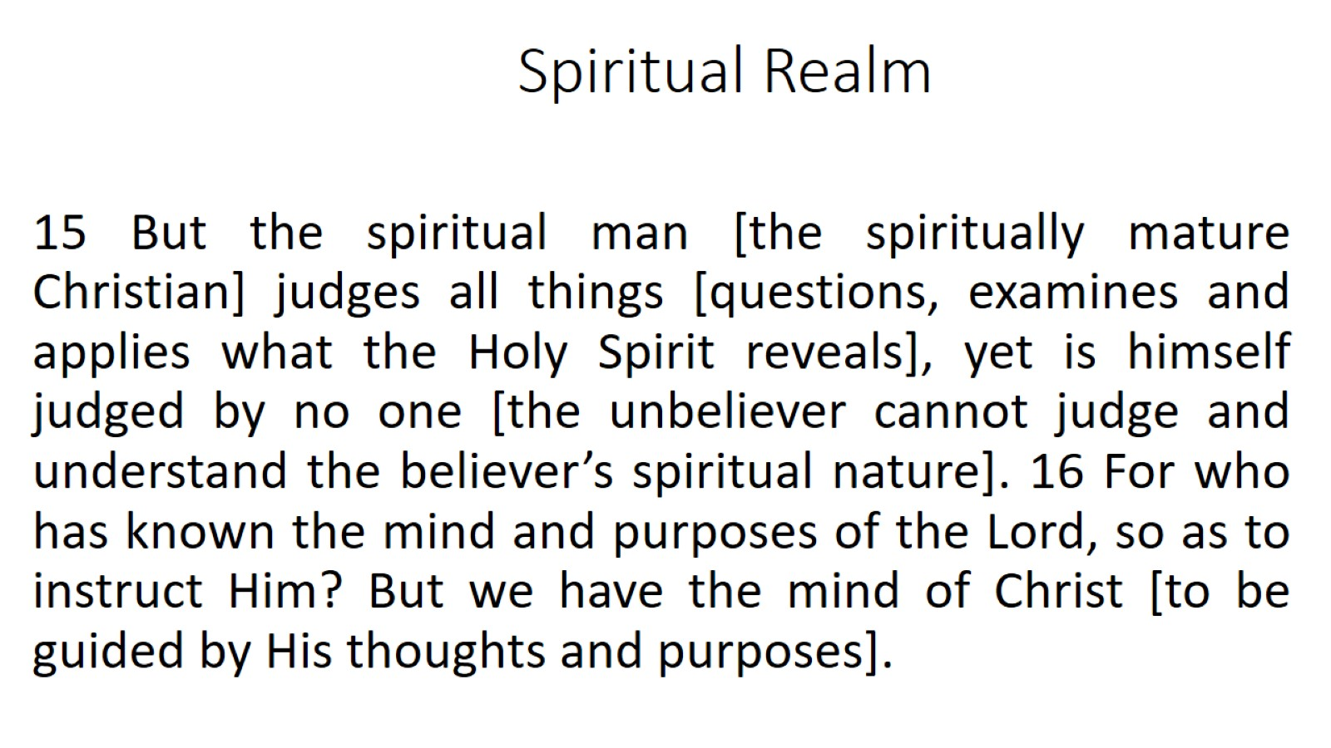
Spiritual Realm

Slide 15
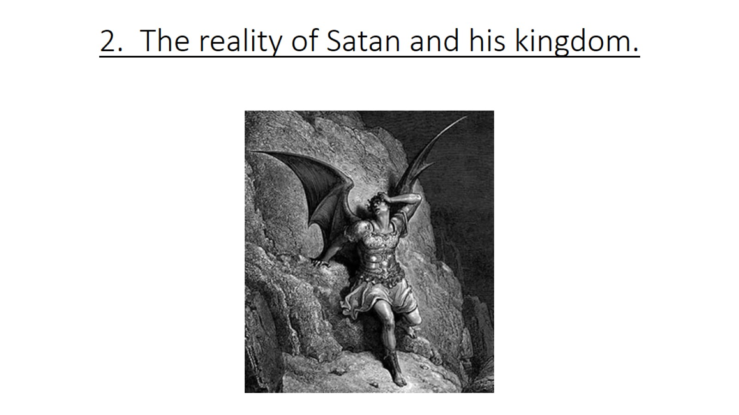
2. The reality of Satan and his kingdom.

Slide 16
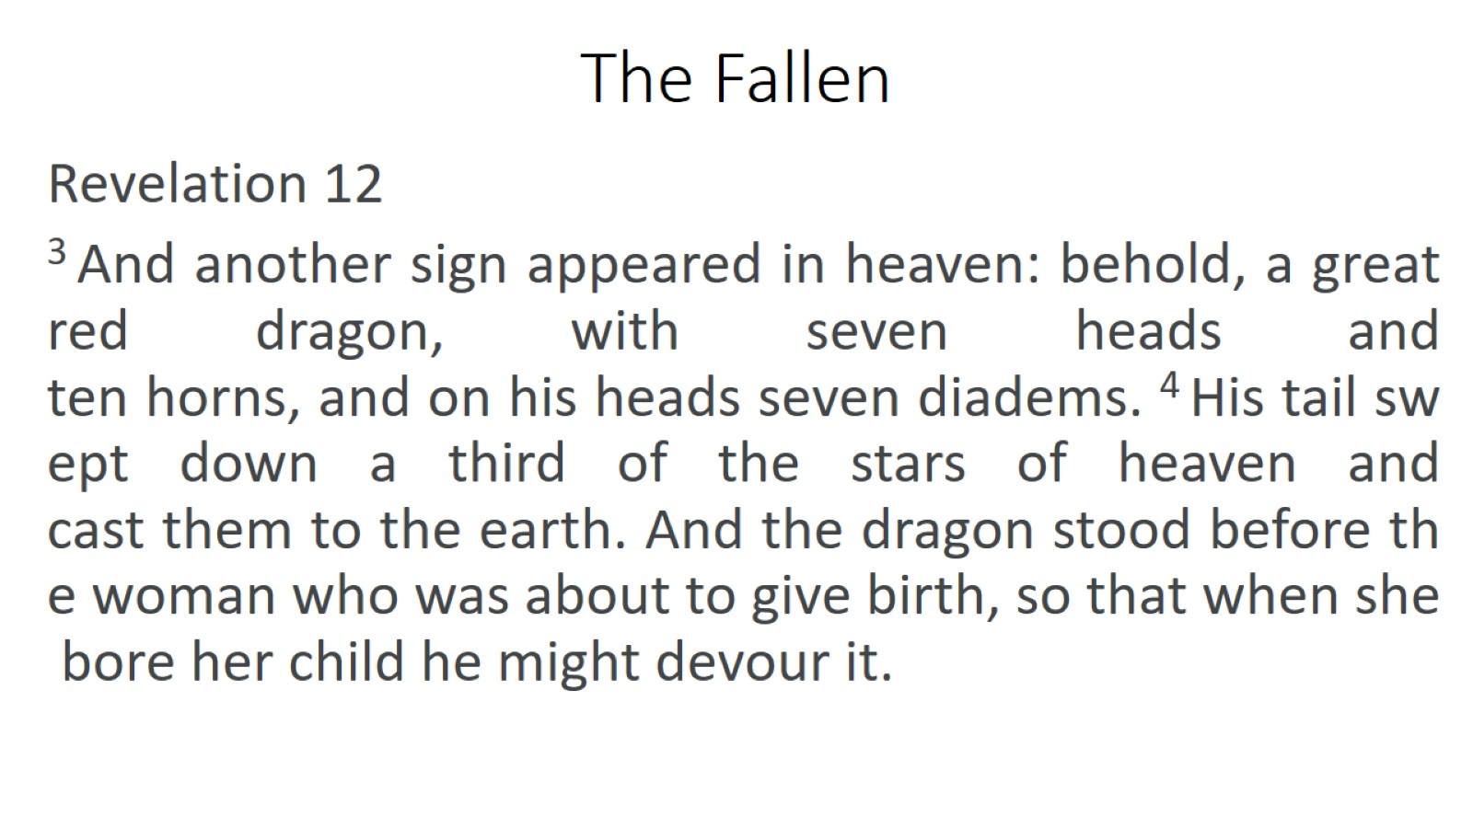
The Fallen

Slide 17
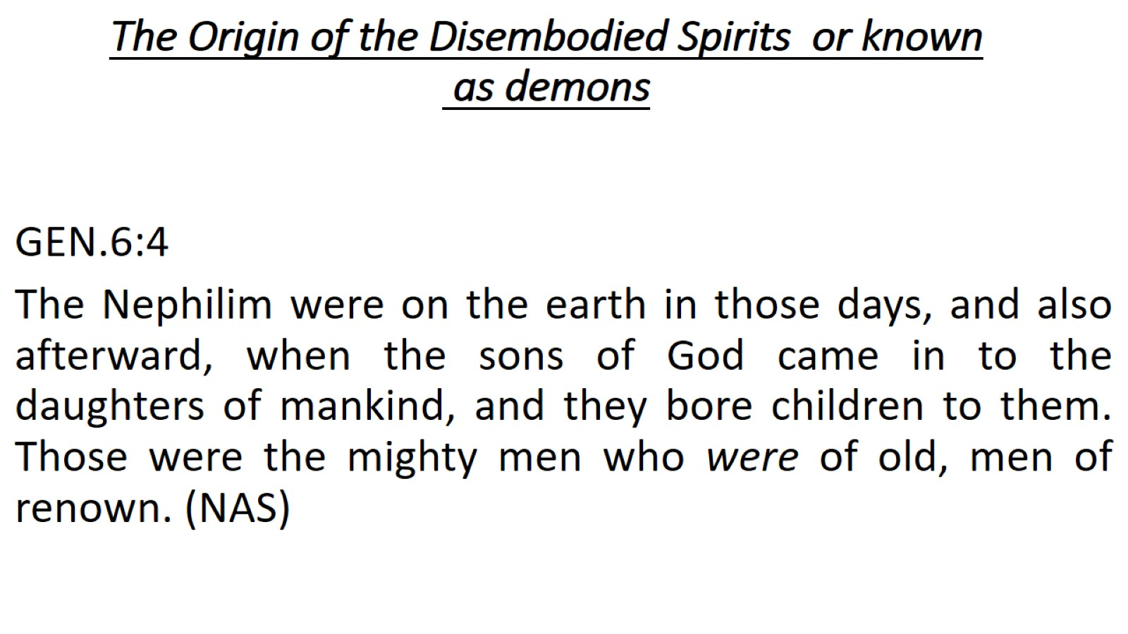
The Origin of the Disembodied Spirits or known as demons

Slide 18
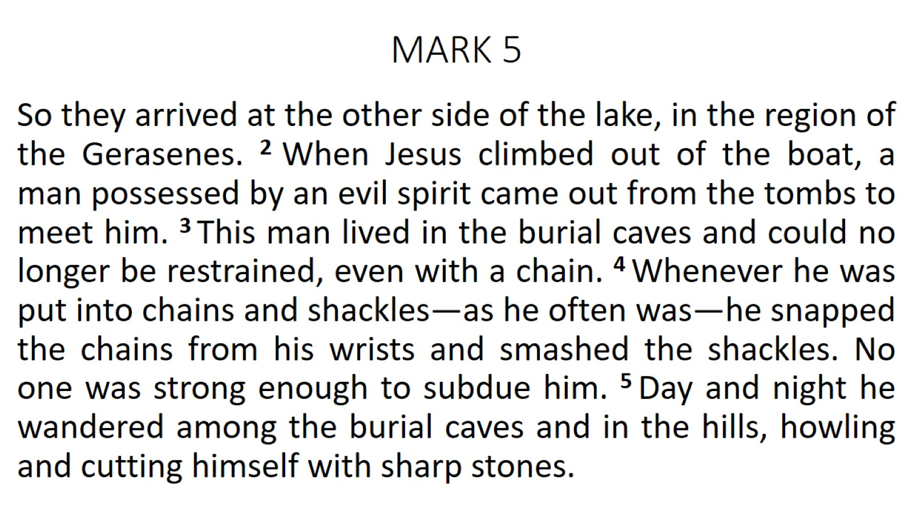
MARK 5

Slide 19
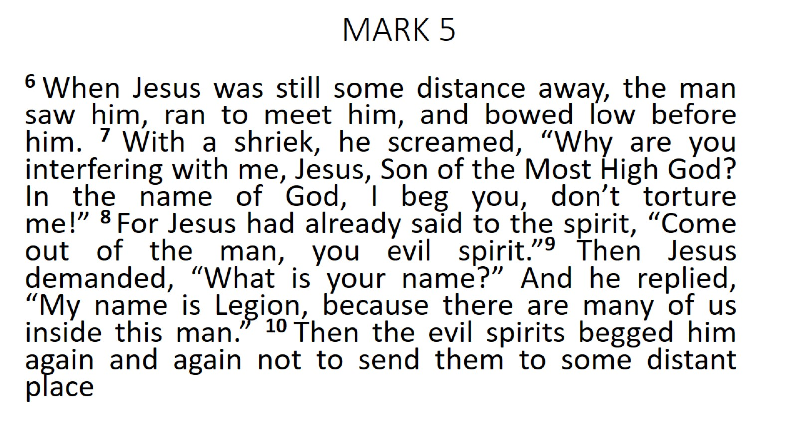
MARK 5

Slide 20
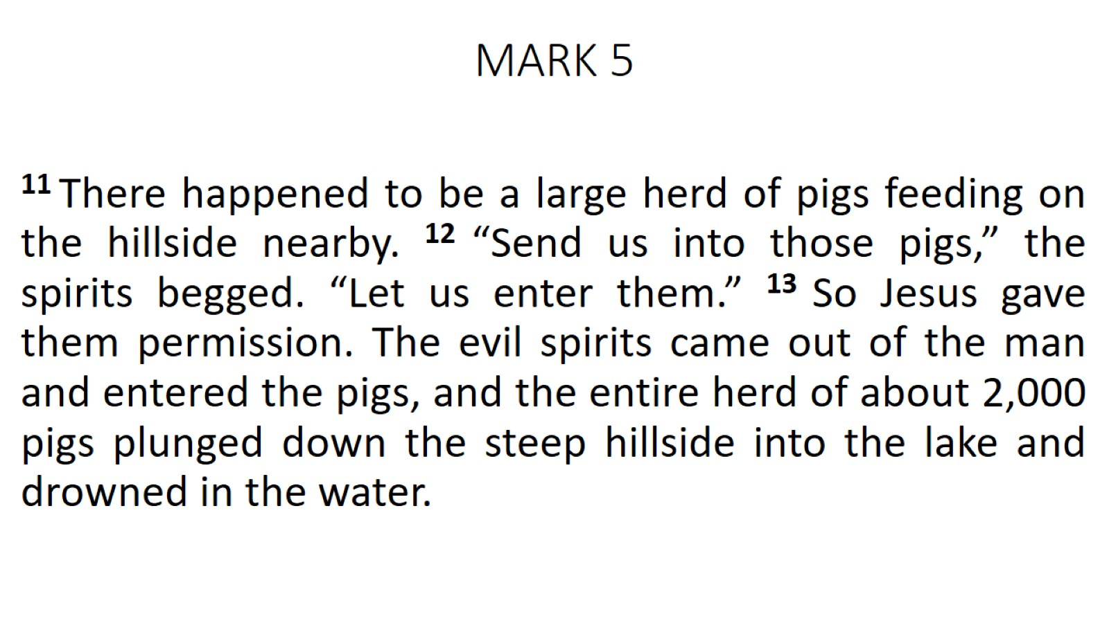
MARK 5

Slide 21
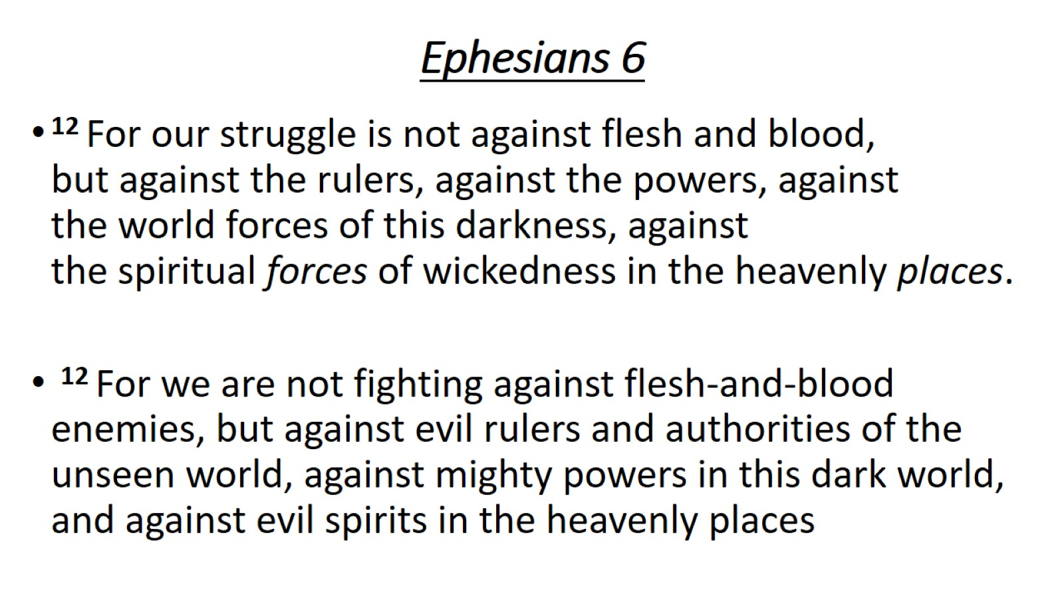
Ephesians 6

Slide 22
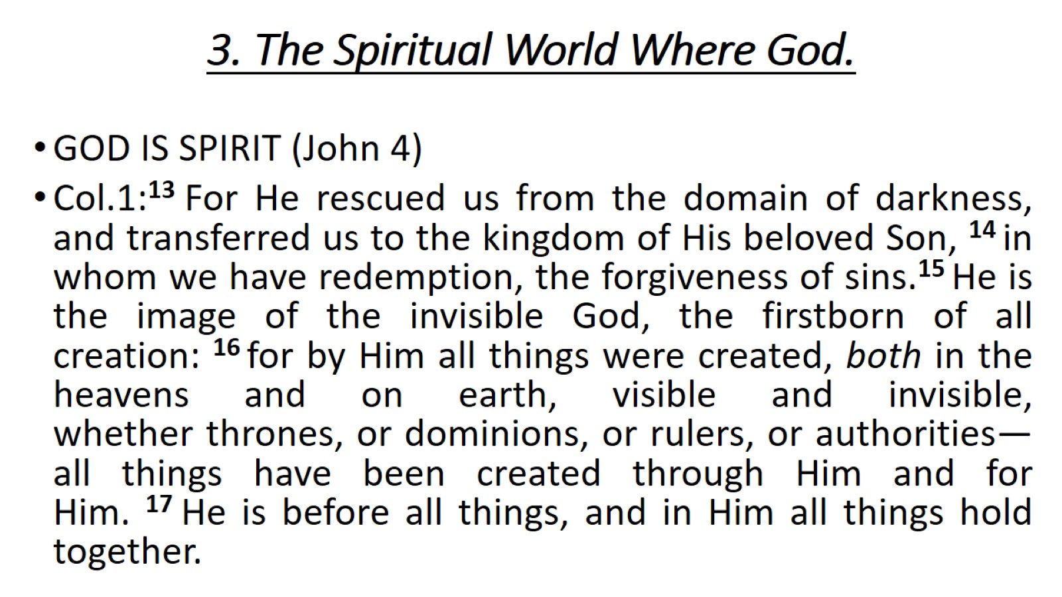
3. The Spiritual World Where God.

Slide 23
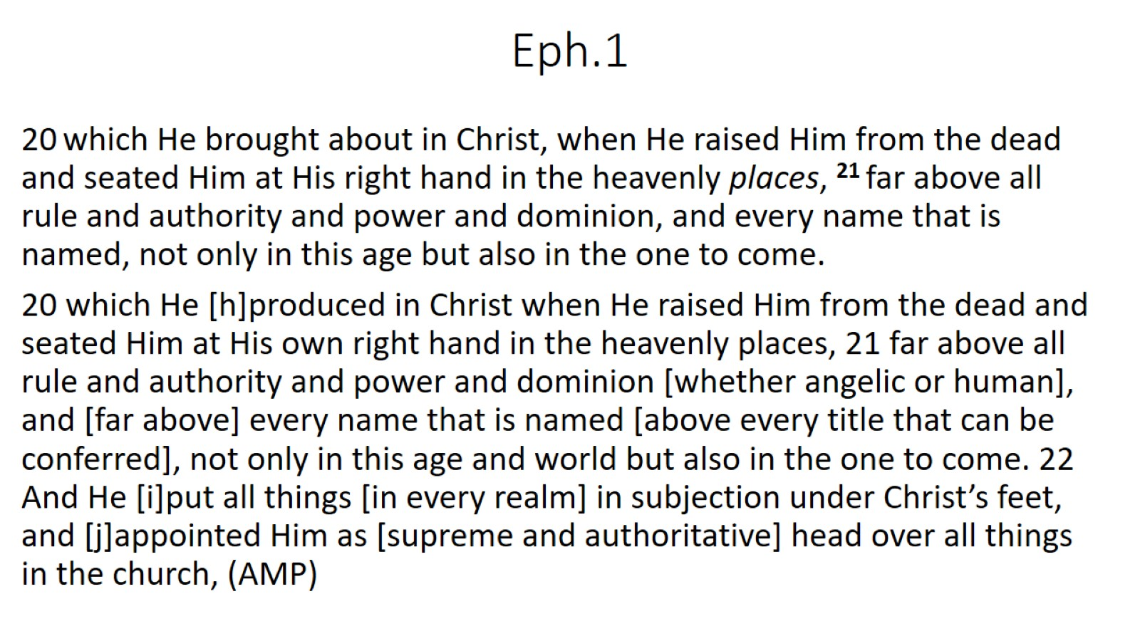
Eph.1

Slide 24
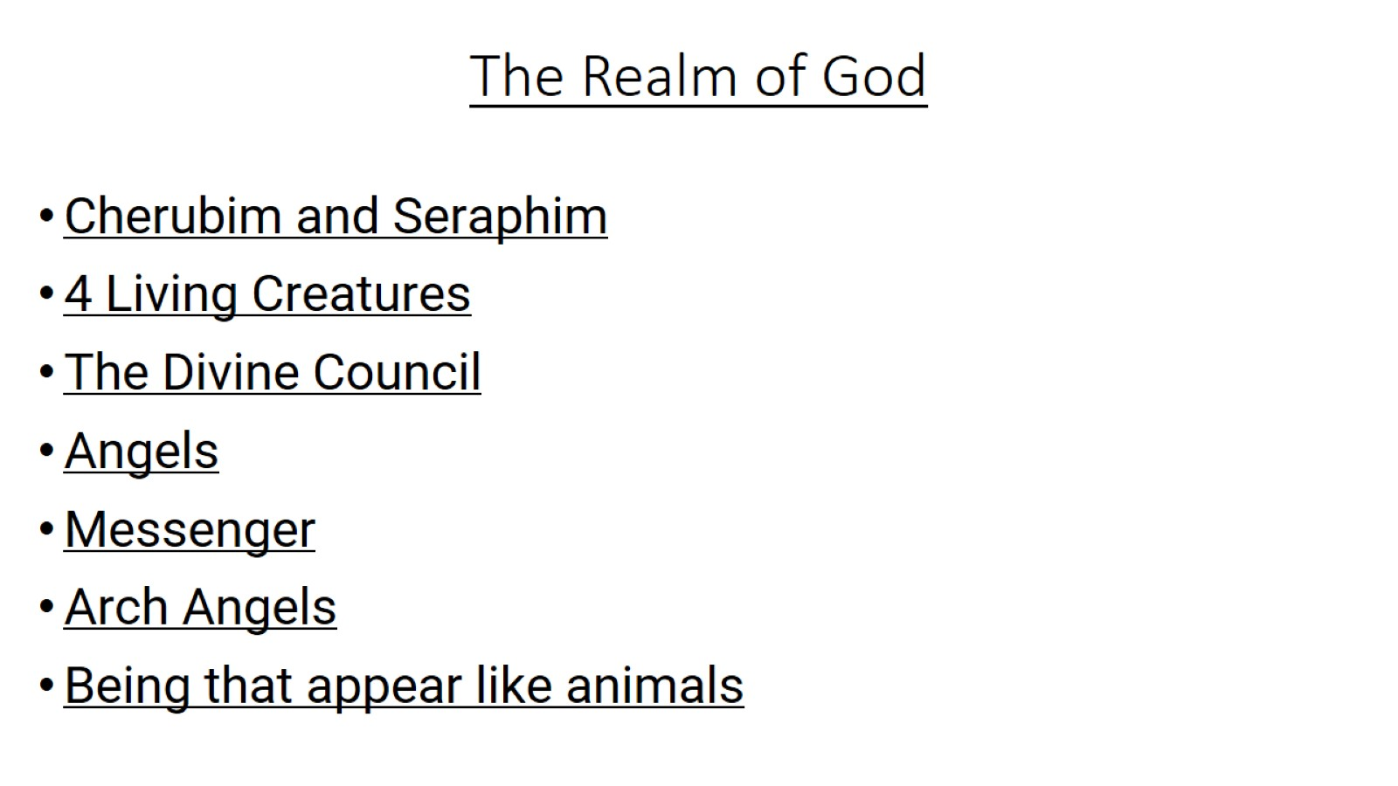
The Realm of God

Slide 25
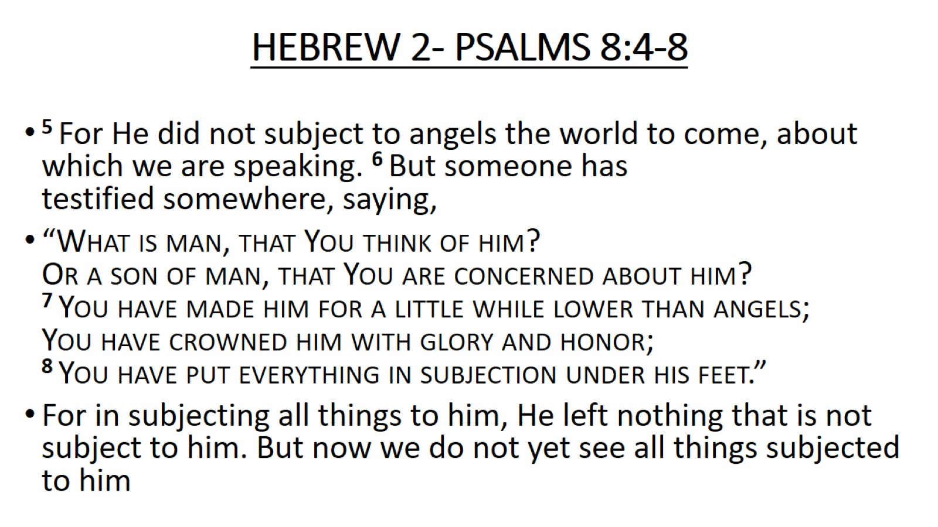
HEBREW 2- PSALMS 8:4-8

Slide 26
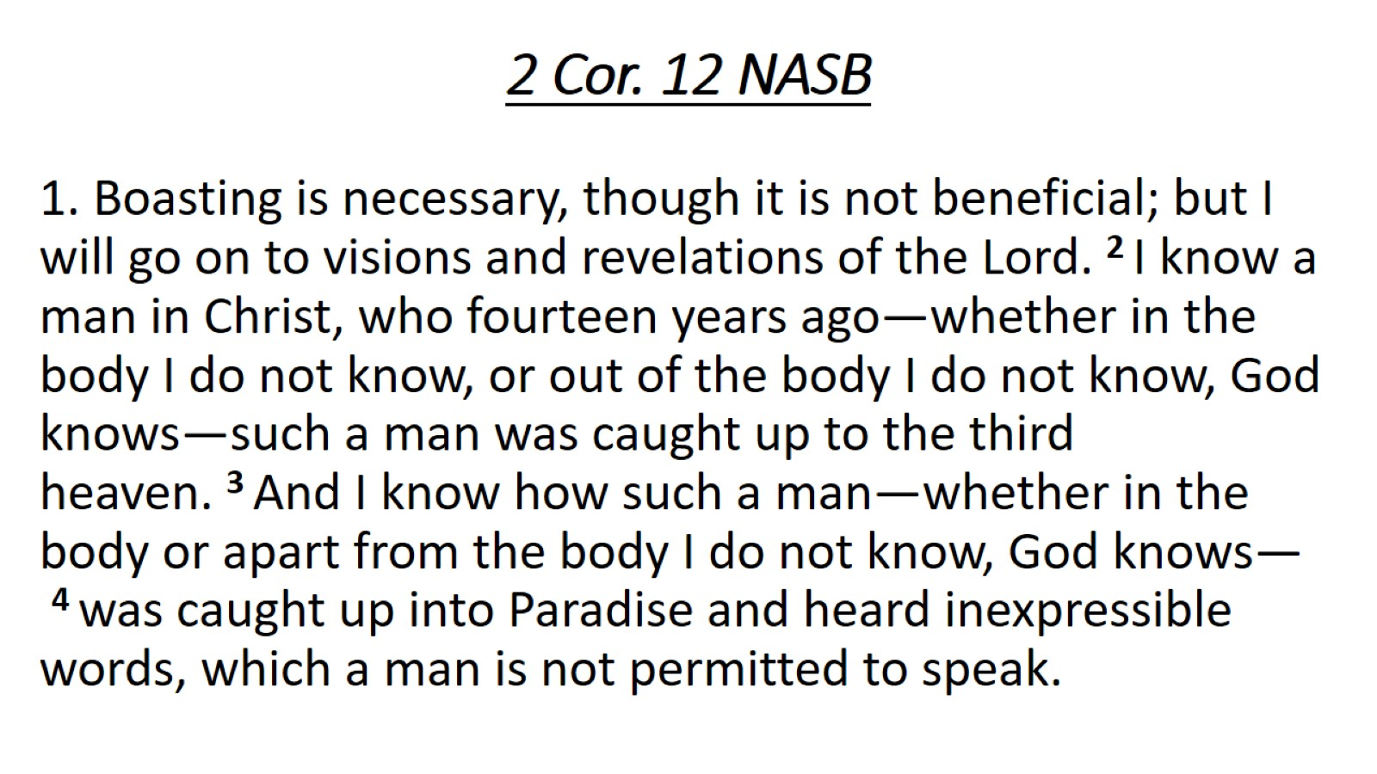
2 Cor. 12 NASB

Slide 27
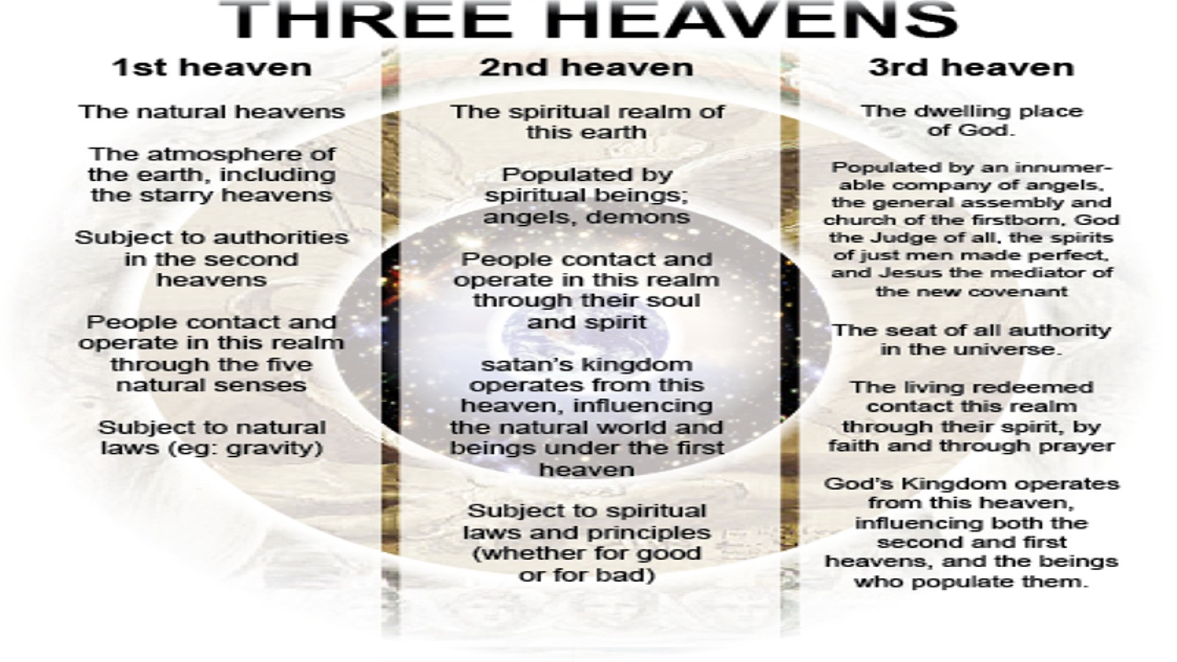
I

Slide 28
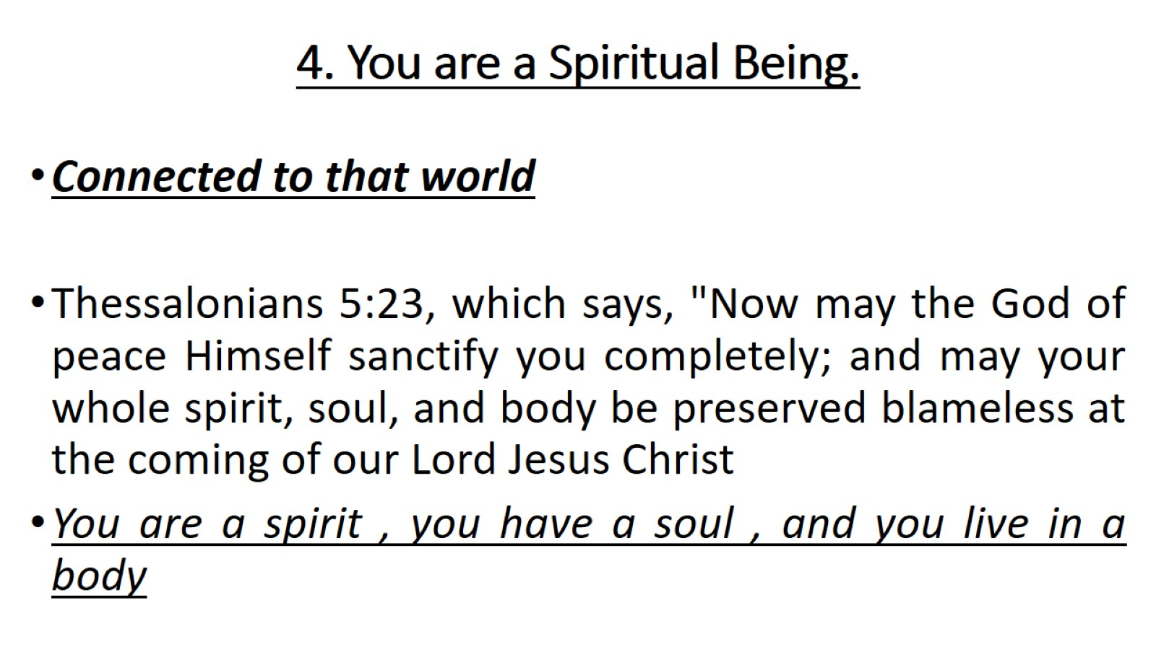
4. You are a Spiritual Being.

Slide 29
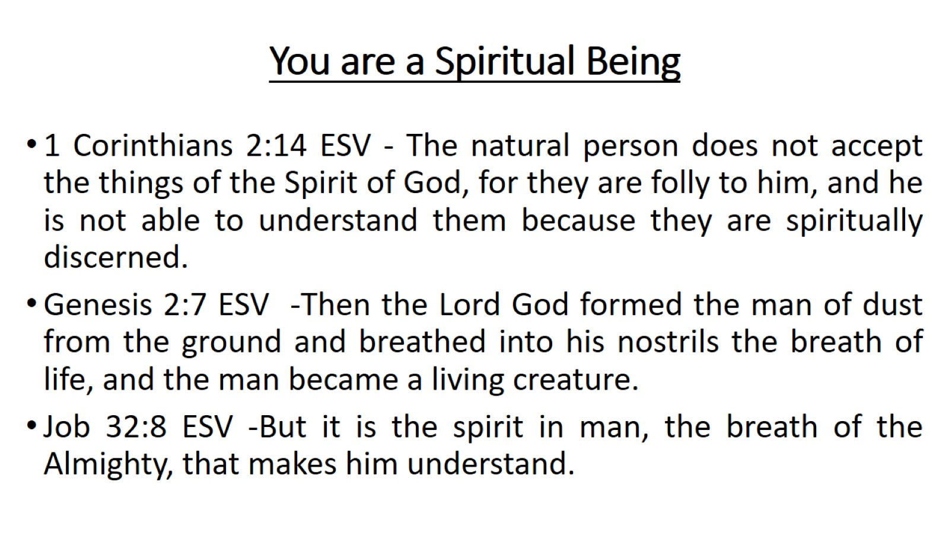
You are a Spiritual Being

Slide 30
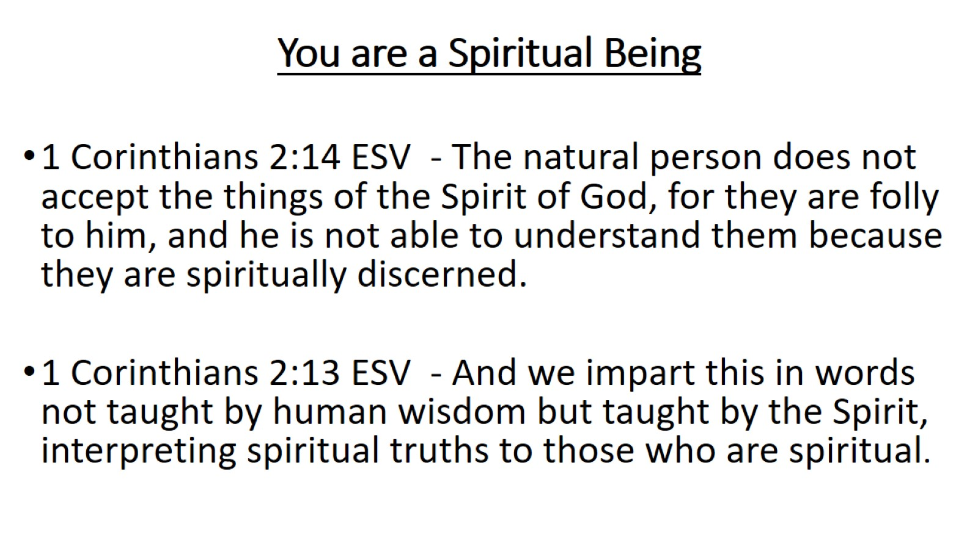
You are a Spiritual Being

Slide 31
