Slide 2
Becoming Something More
in Christ

Slide 3
Without consulting anybody,
God takes a nobody
and turns them into a somebody
in front of everybody.

Slide 4
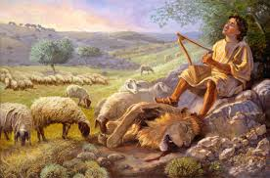

Slide 5
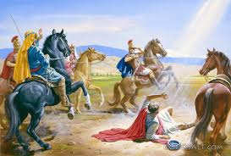

Slide 6
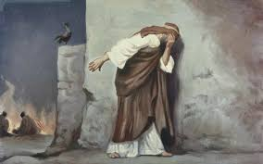

Slide 7
Where are you in the process?
The more you realize that you are an undeserving nobody, the more grateful you become when you realize that Jesus has made you somebody to him.

Slide 8
Proverbs 25:4-5 - Take away the dross from the silver, and the smith has material for a vessel;
⁵ take away the wicked from the presence of the king,
and his throne will be established in righteousness.

Slide 9
In the Bible, dross is a mass of solid impurities that floats on molten metal and has no value. It’s used figuratively to describe what is base or worthless.

Slide 10
Galatians 2:20 TPT
My old identity has been co-crucified with Christ and no longer lives. And now the essence of this new life is no longer mine, for the Anointed One lives his life through me – we live in union as one! My new life is empowered by the faith of the Son of God who loves me so much that he gave himself for me, dispensing his life into mine.

Slide 11
Galatians 6:7-10
God will never be mocked! For what you plant will always be the very thing you harvest. 8 The harvest you reap reveals the seed that you planted. If you plant the corrupt seeds of self-life into this natural realm, you can expect a harvest of corruption. If you plant the good seeds of Spirit-life you will reap beautiful fruits that grow from the everlasting life of the Spirit.

Slide 12
9 And don’t allow yourselves to be weary in planting good seeds, for the seasons of reaping the wonderful harvest you’ve planted is coming! 10 Take advantage of every opportunity to be a blessing to others, especially to our brothers and sisters in the family of faith!

Slide 13
Good Seeds include:
prayerful communion with God, learning His Word, speaking wise words, giving, loving, and dropping ‘seeds’ of love and truth every day from our new life in Christ.

Slide 14
A nobody who God has made a somebody can perceive another nobody who God has made a somebody.
Galatians 2:9
and when James and Cephas and John, who seemed to be pillars, perceived the grace that was given to me, they gave the right hand of fellowship to Barnabas and me….

Slide 15
Has something radical happened in your life because of Jesus Christ?
Has your encounter with Him transformed your viewpoint of your life’s purpose?
Does He matter more to you that anything else?
Do you maintain a fire in your heart for being with Him and fulfilling His purpose for your life?

Slide 16
Philippians 3:12-14 TPT
I admit that I haven’t yet acquired the absolute fullness that I’m pursuing, but I run with passion into his abundance so that I may reach the purpose for which Christ Jesus late hold of me to make me his own. 13 I don’t depend on my own strength to accomplish this; however, I do have one compelling focus: I forget all of the past as I fasten my heart to the future instead. 14 I run straight for the divine invitation of reaching the heavenly goal and gaining the victory price through the anointing of Jesus.

Slide 17
“Ah, but a man’s reach should exceed his grasp it, Or what’s a Heaven for?” – Robert Browning

Slide 18
A nobody who Christ has made a somebody to Him maintains a passionate to pursuit of Jesus.

