Slide 1


Slide 2
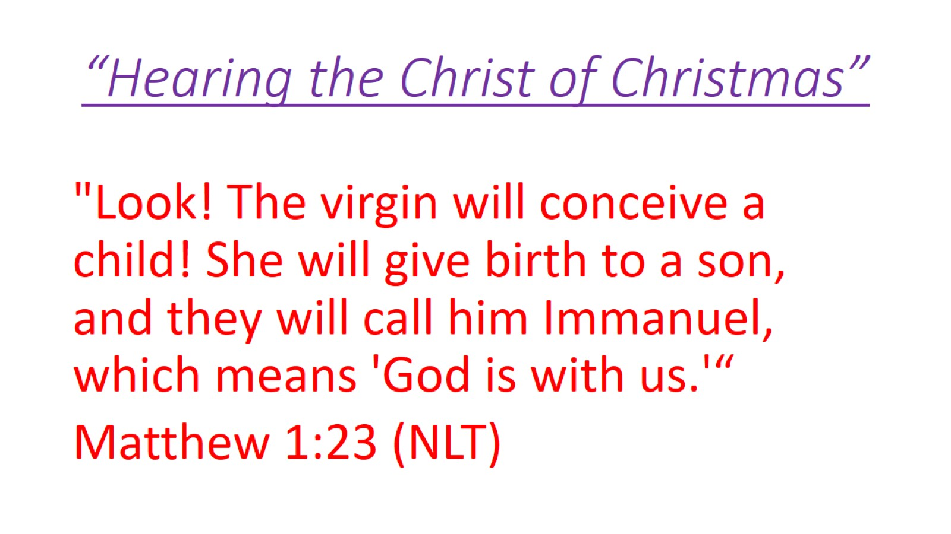
“Hearing the Christ of Christmas”

Slide 3
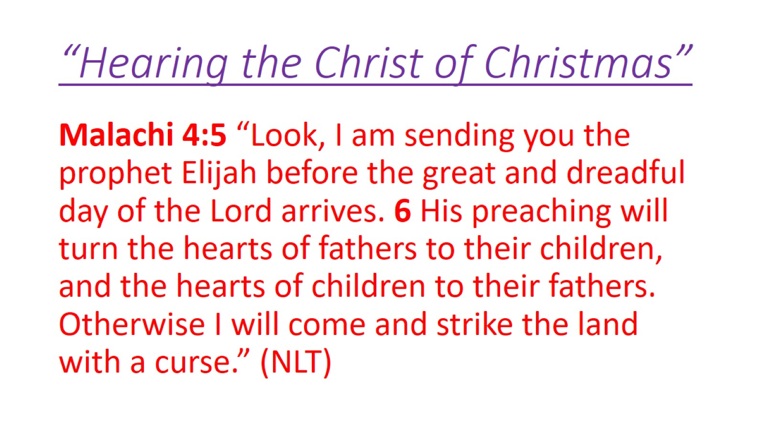
“Hearing the Christ of Christmas”

Slide 4
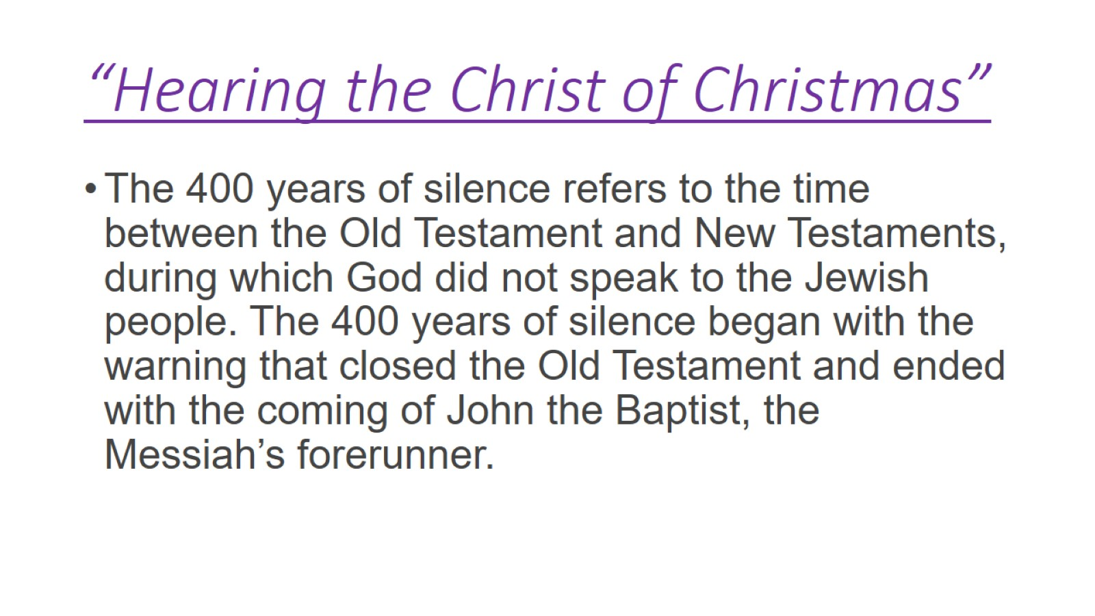
“Hearing the Christ of Christmas”

Slide 5
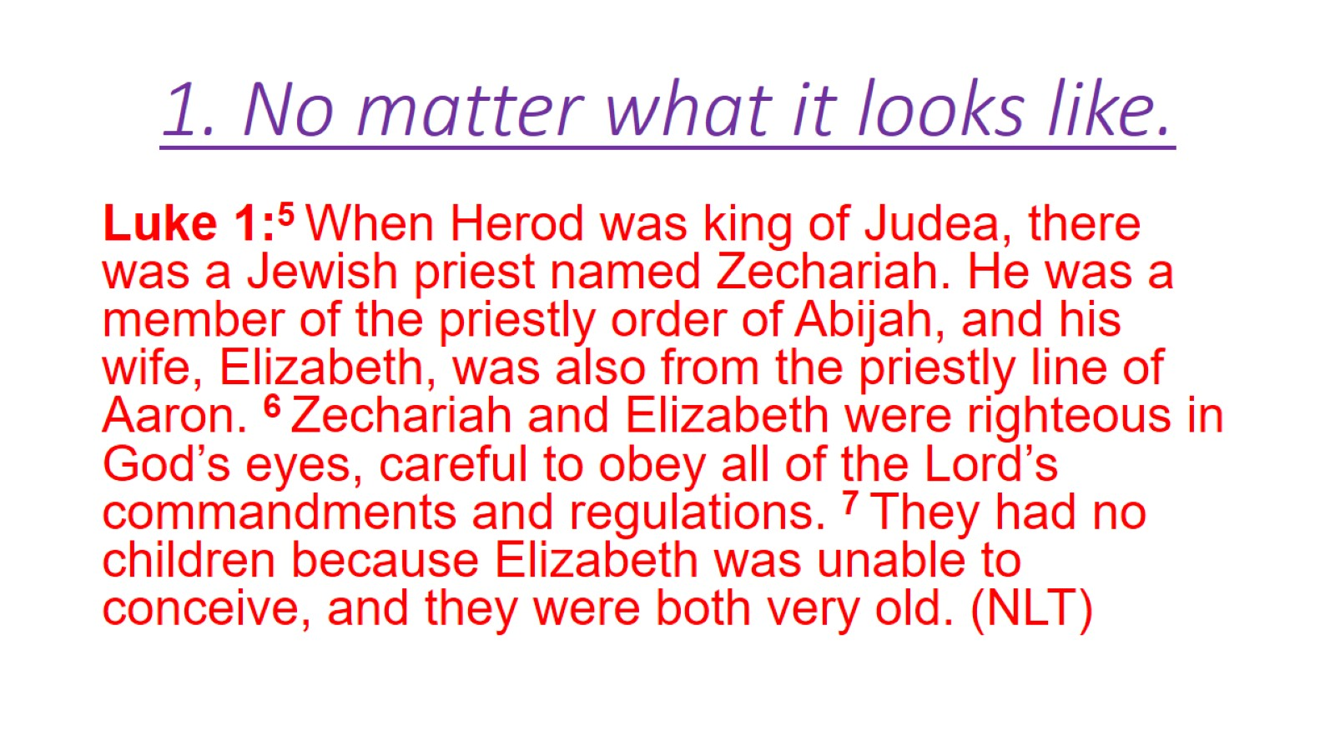
1. No matter what it looks like.

Slide 6
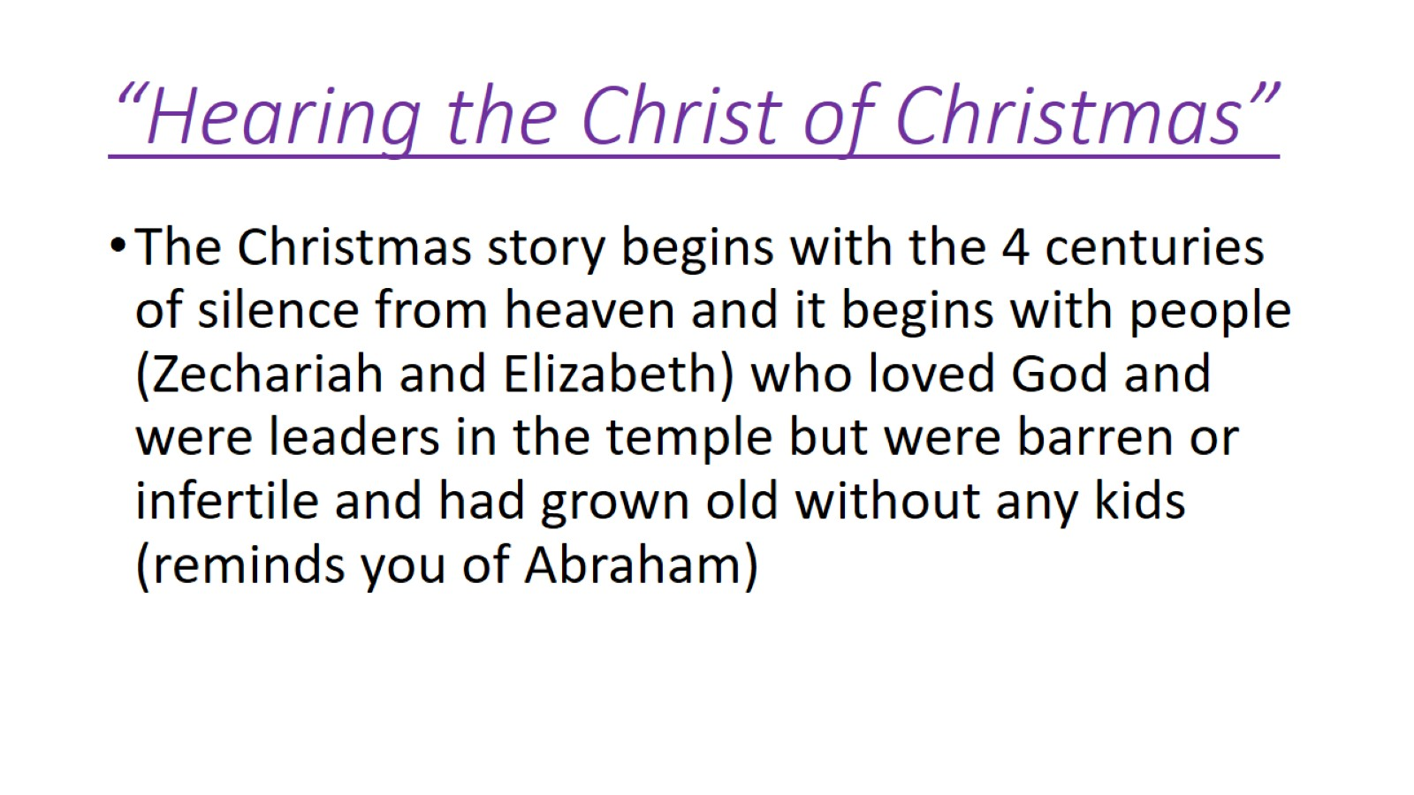
“Hearing the Christ of Christmas”

Slide 7
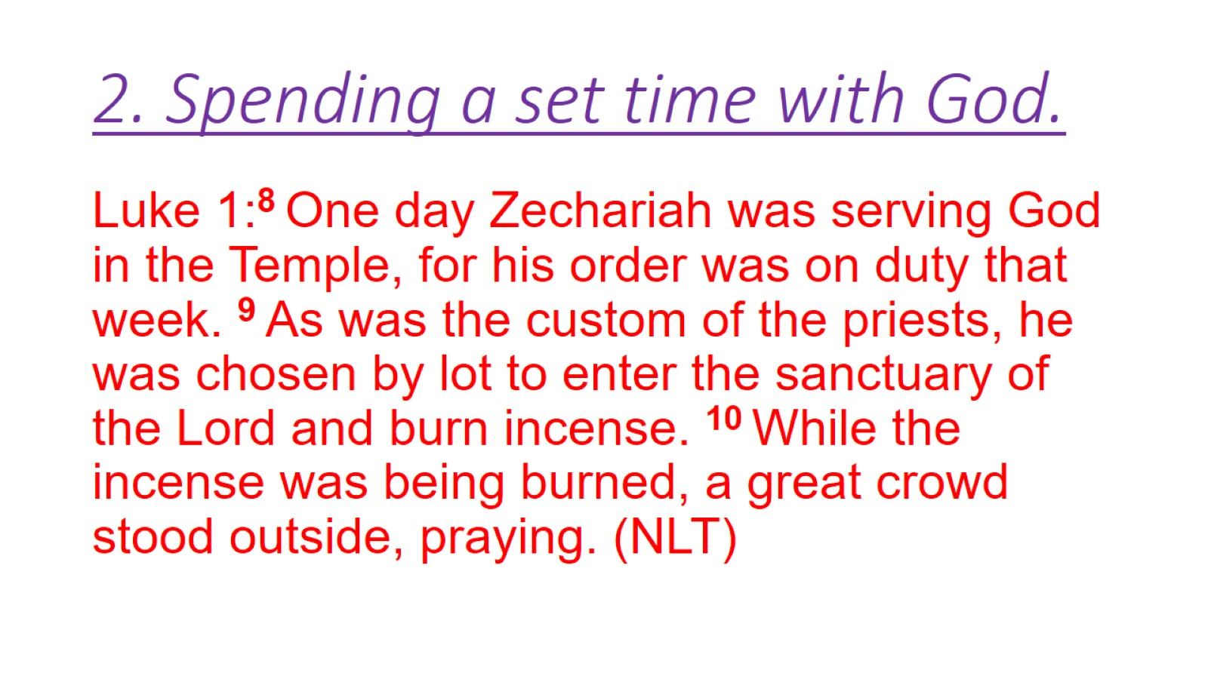
2. Spending a set time with God.

Slide 8
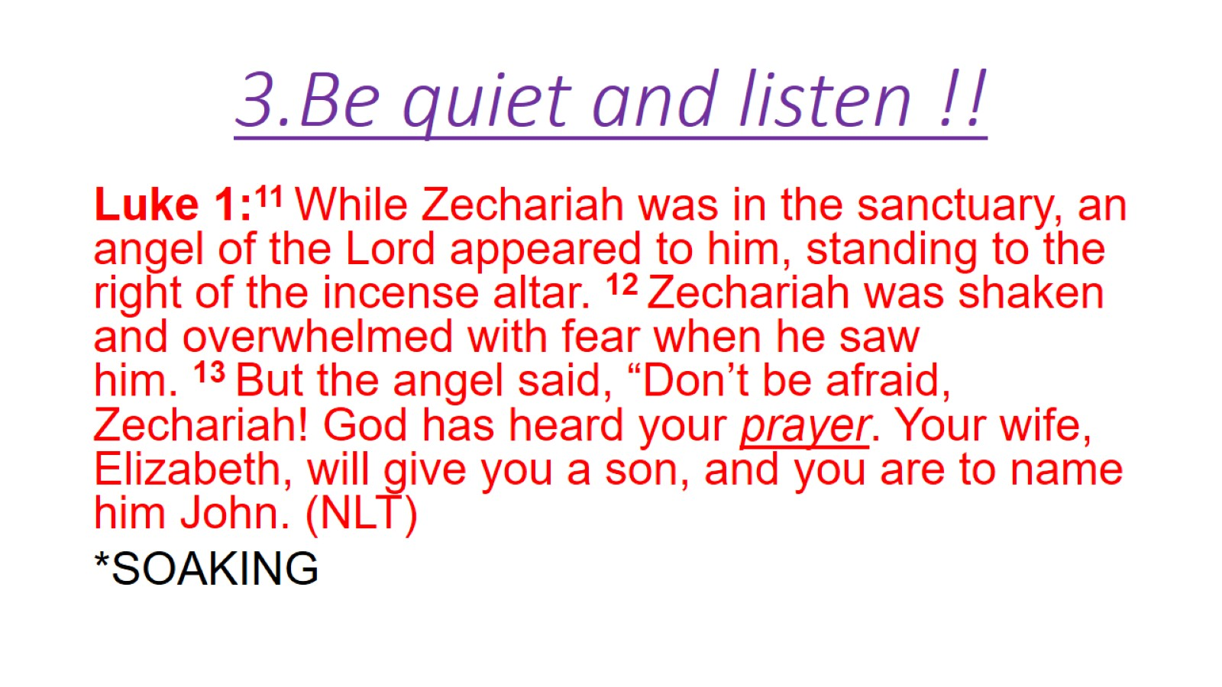
3.Be quiet and listen !!

Slide 9
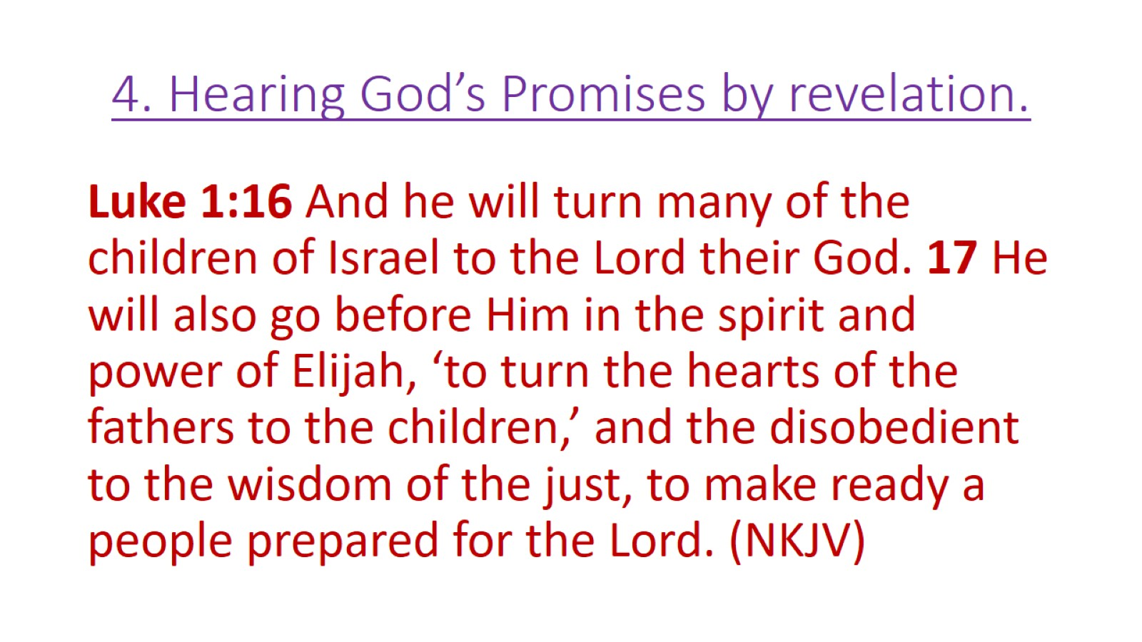
4. Hearing God’s Promises by revelation.

Slide 10
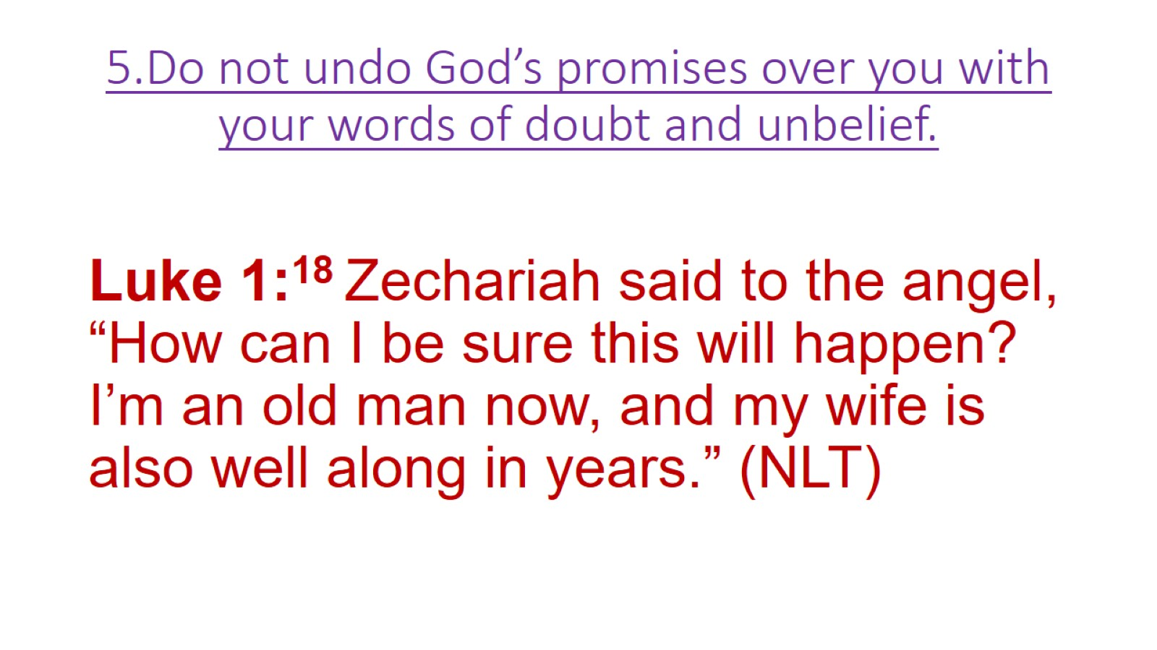
5.Do not undo God’s promises over you with your words of doubt and unbelief.

Slide 11
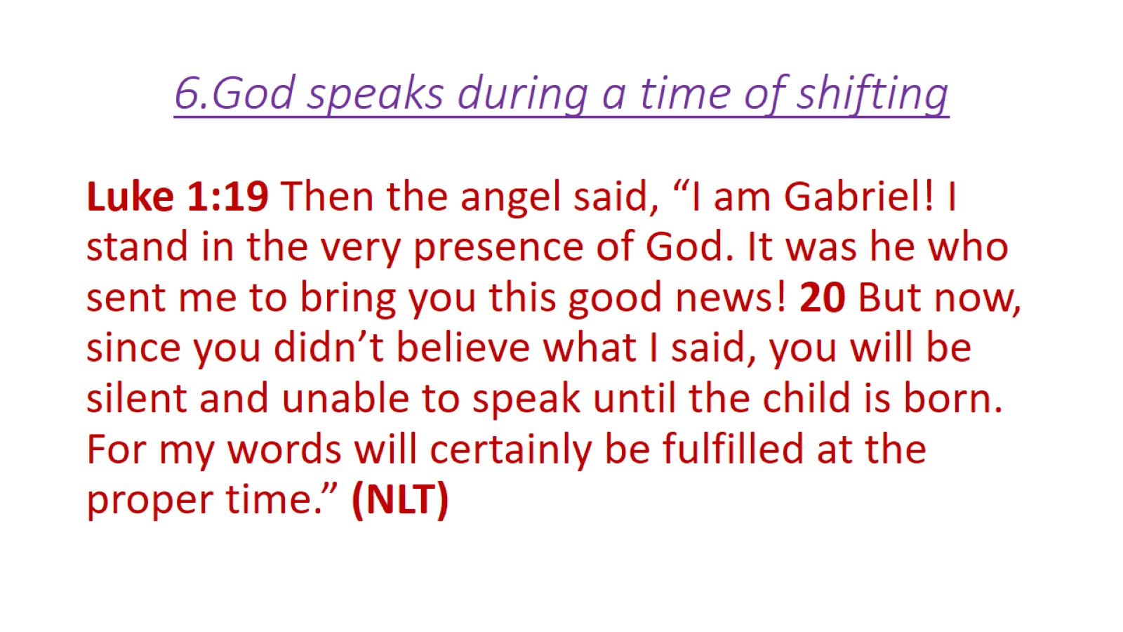
6.God speaks during a time of shifting

Slide 12
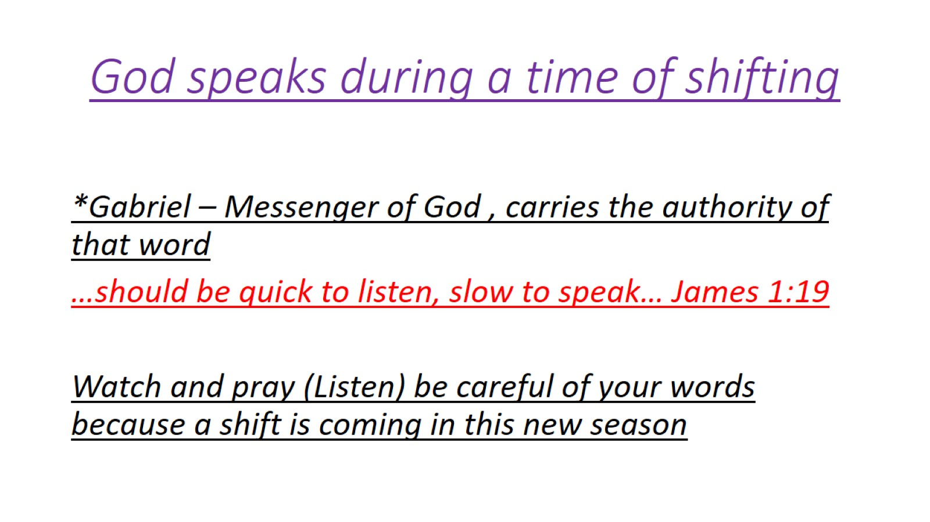
God speaks during a time of shifting

Slide 13
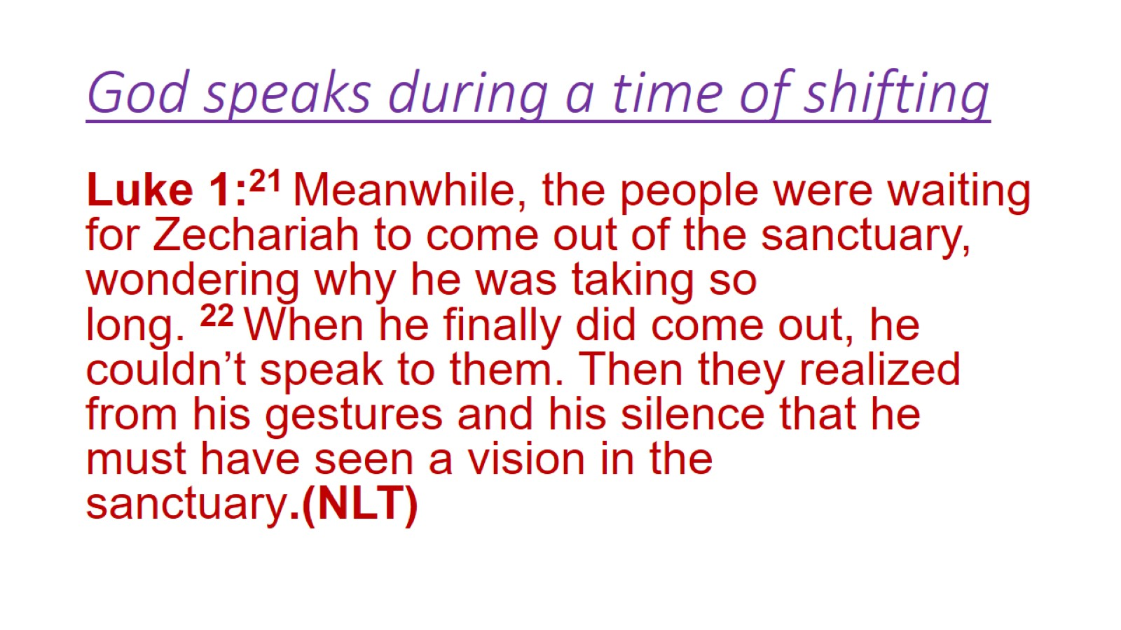
God speaks during a time of shifting

Slide 14
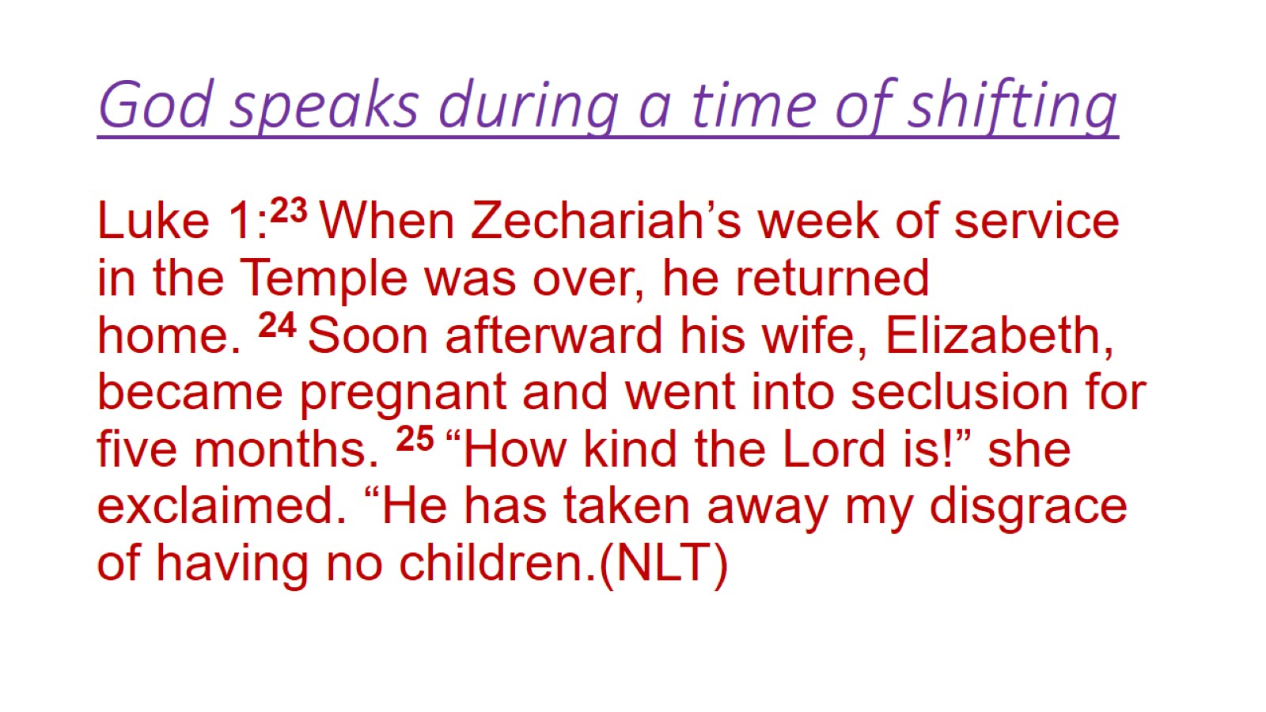
God speaks during a time of shifting

Slide 15
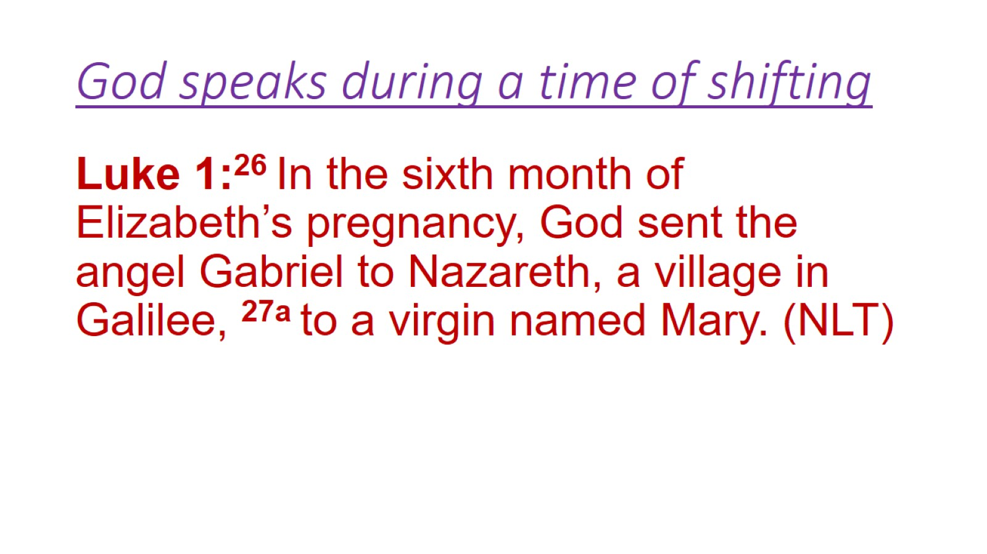
God speaks during a time of shifting

Slide 16
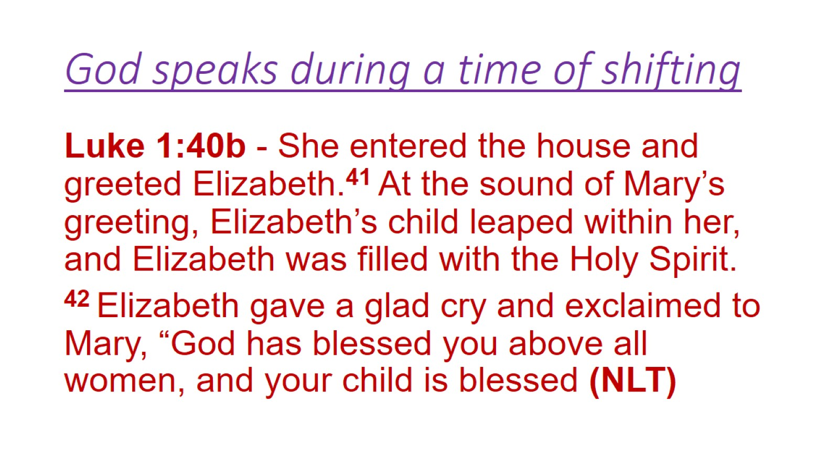
God speaks during a time of shifting

Slide 17
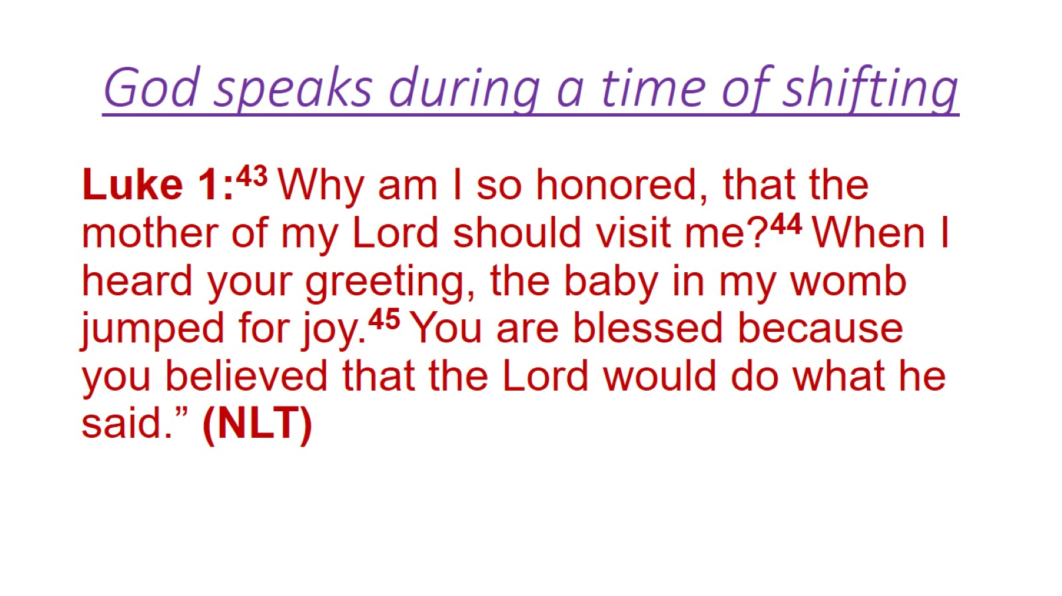
God speaks during a time of shifting

Slide 18
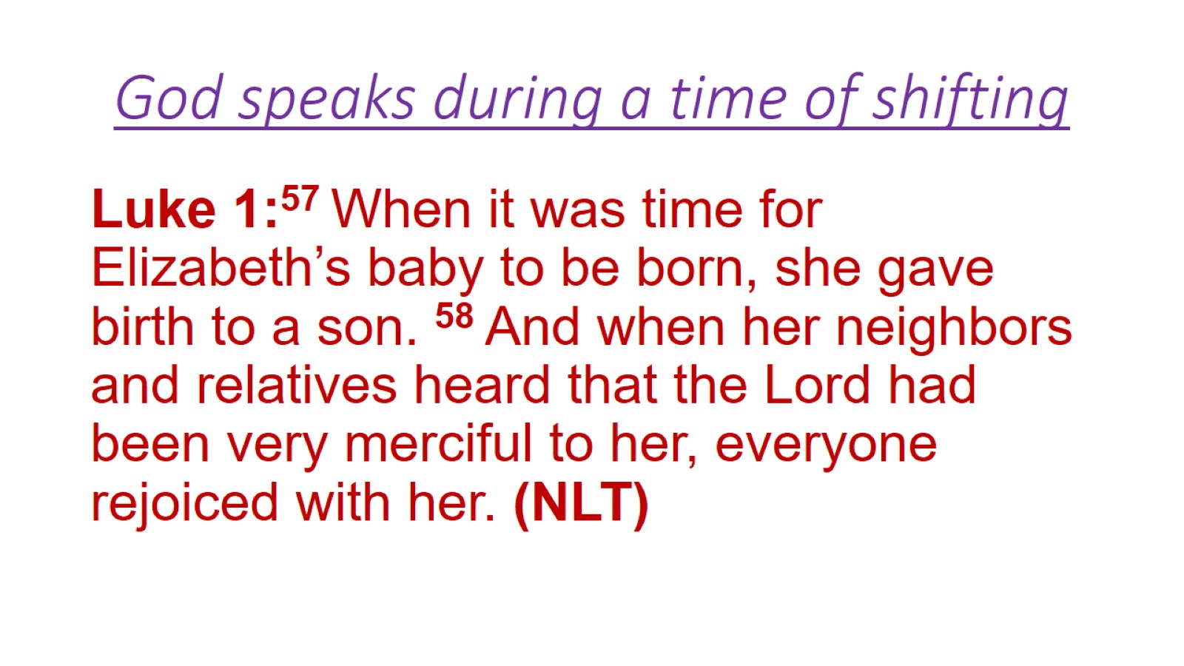
God speaks during a time of shifting

Slide 19
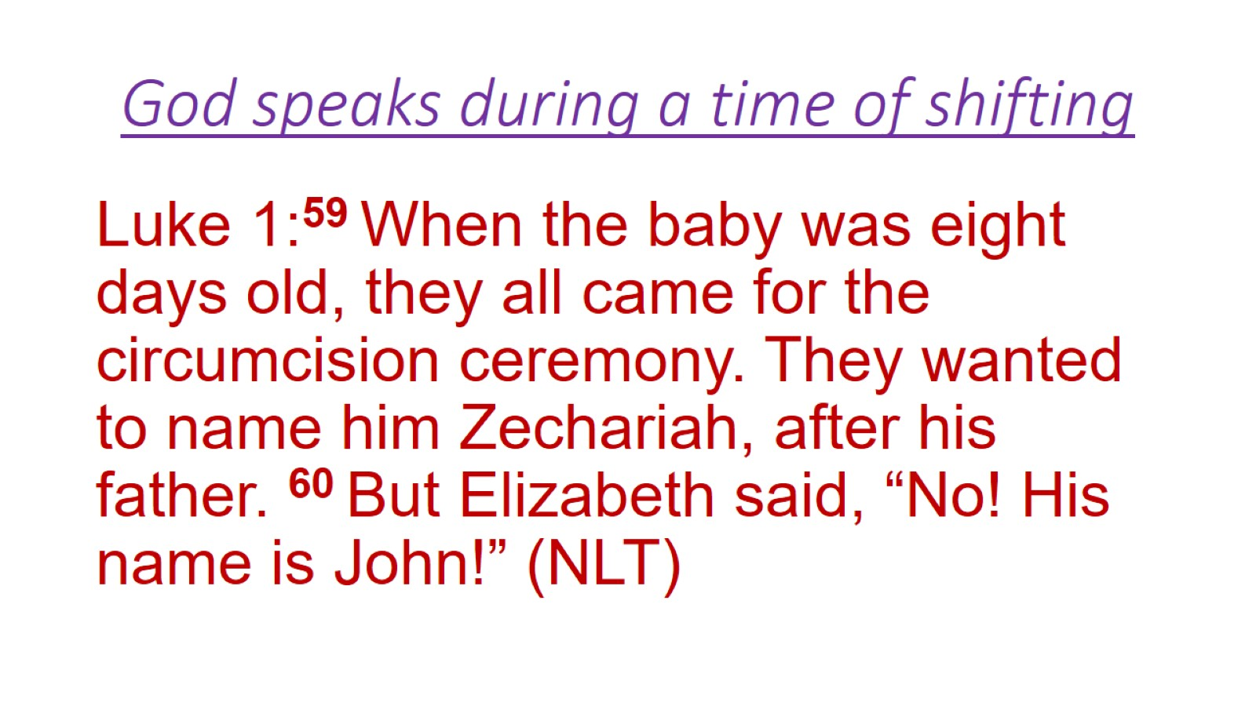
God speaks during a time of shifting

Slide 20
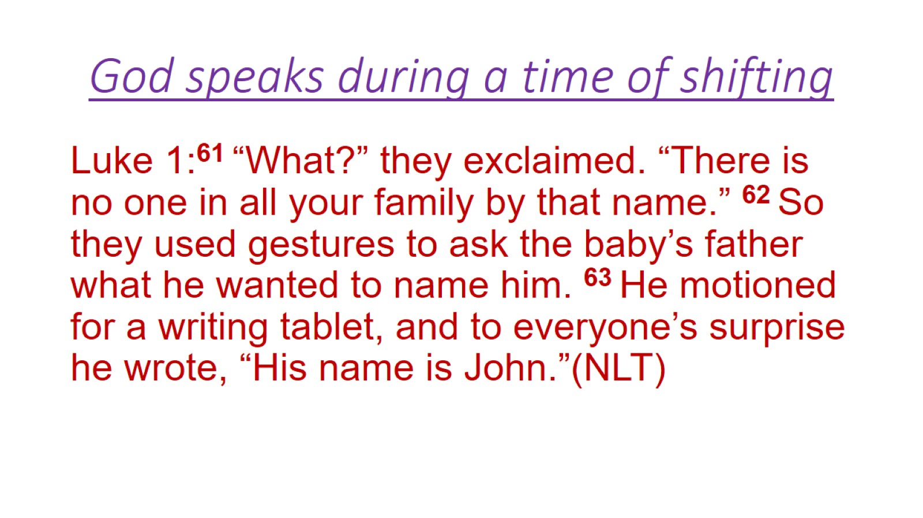
God speaks during a time of shifting

Slide 21
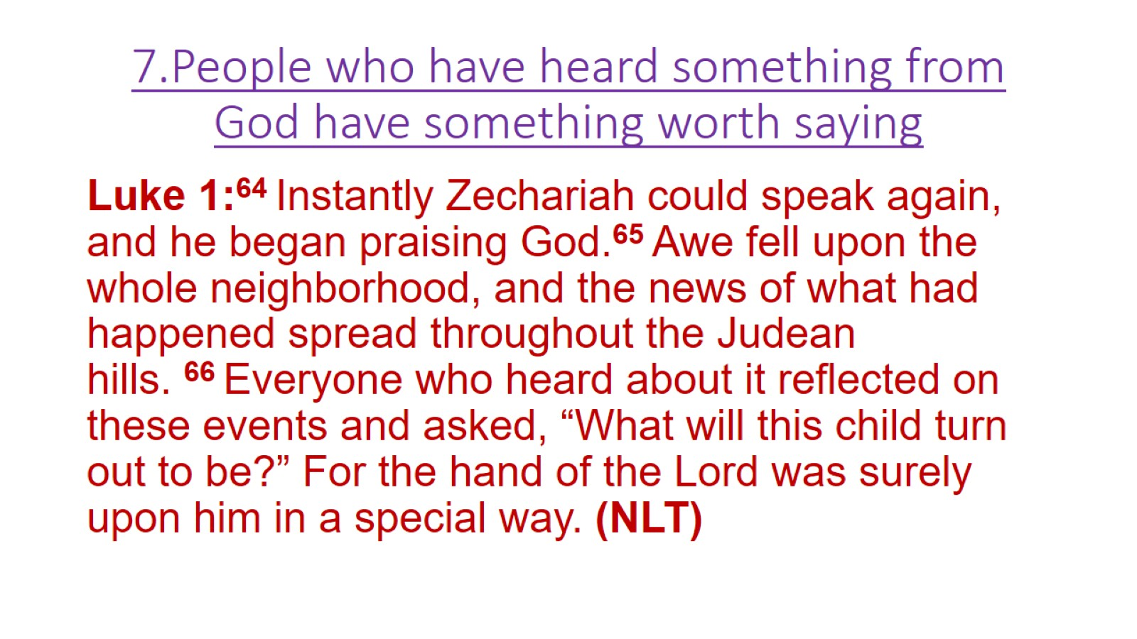
7.People who have heard something from God have something worth saying

Slide 22
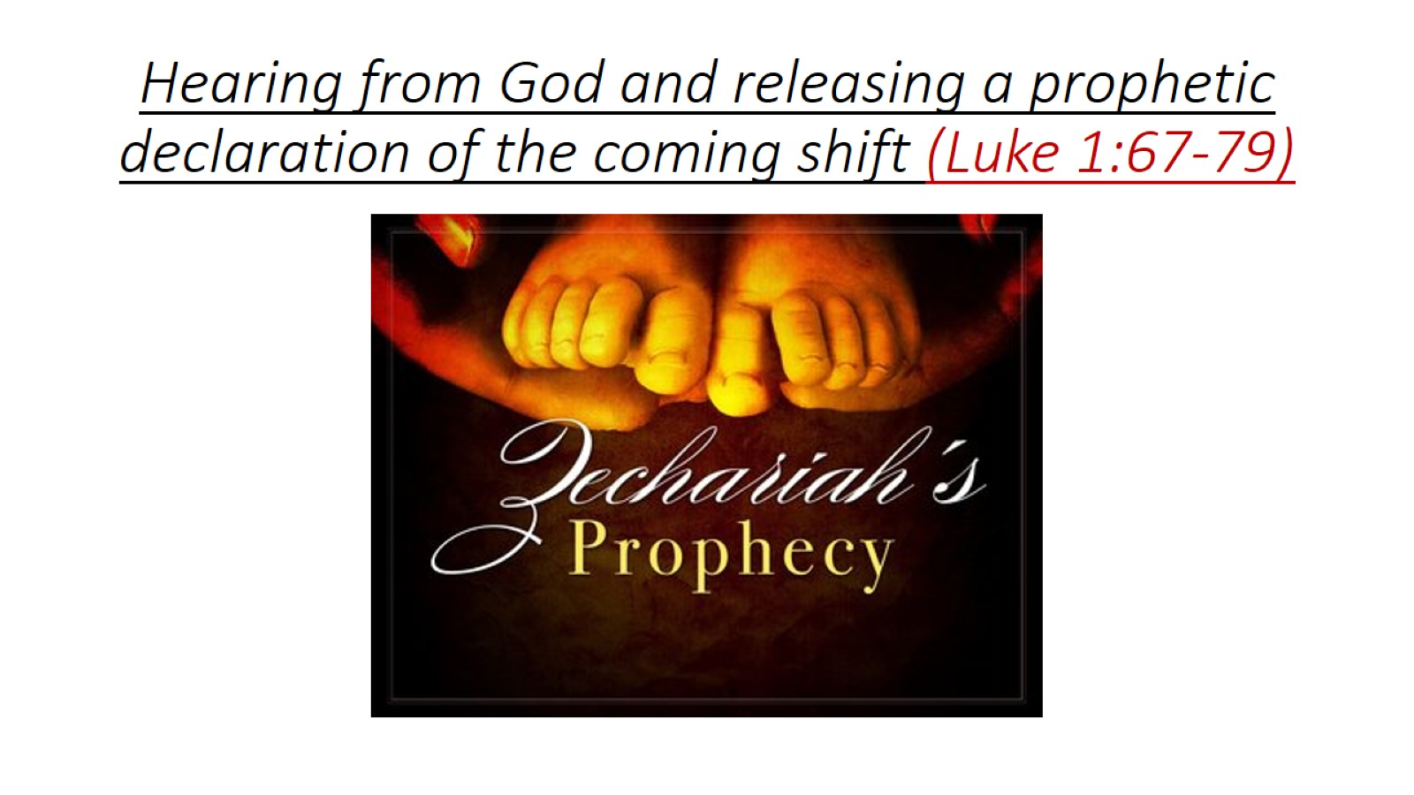
Hearing from God and releasing a prophetic declaration of the coming shift (Luke 1:67-79)

