Slide 1


Slide 2


Slide 3
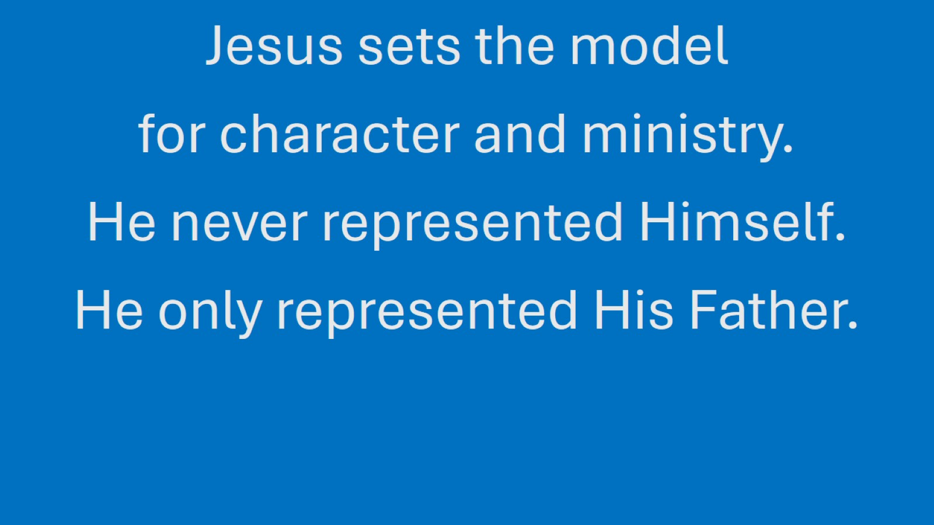

Slide 4
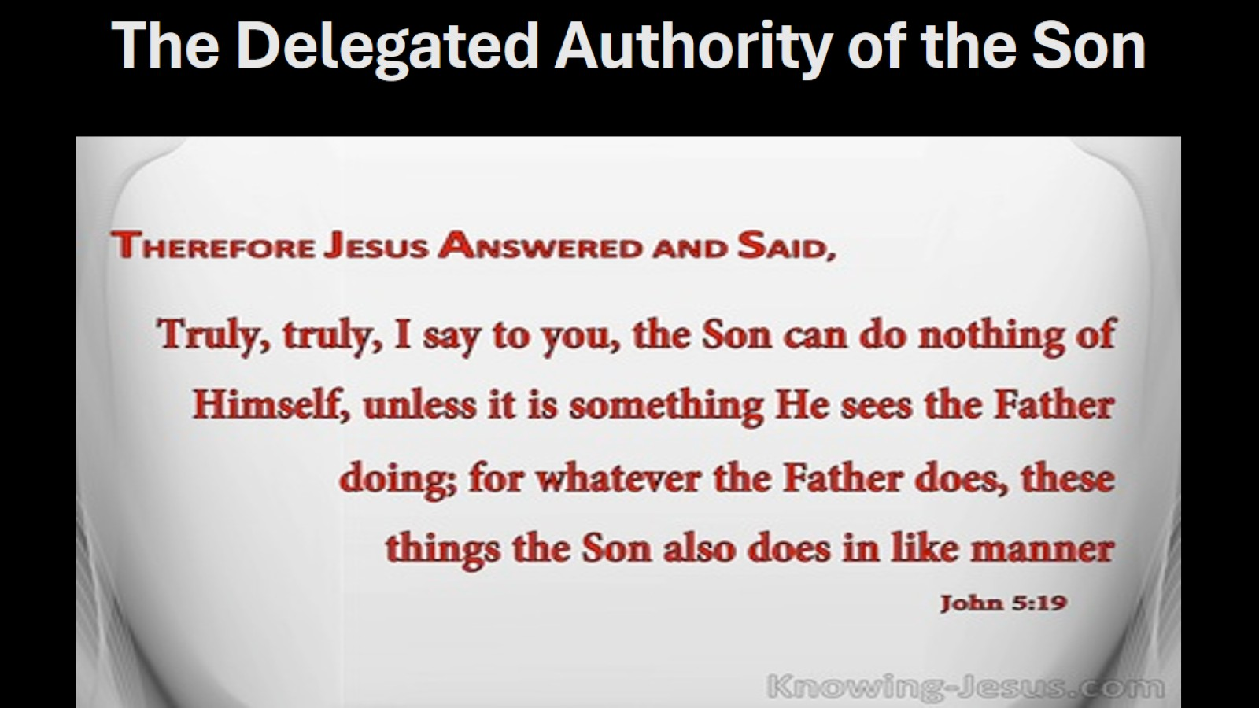
The Delegated Authority of the Son

Slide 5
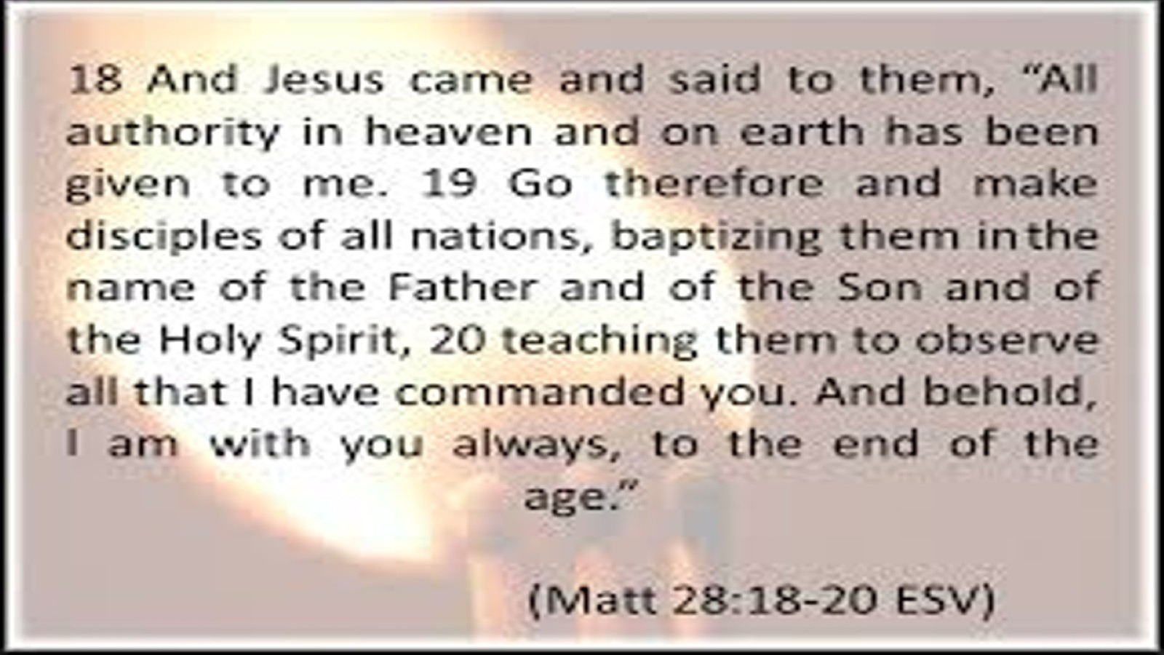

Slide 6
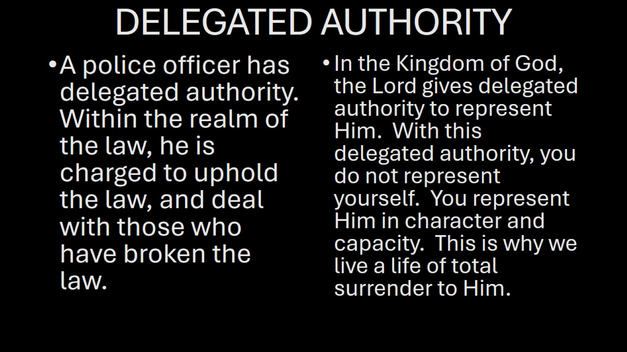
DELEGATED AUTHORITY

Slide 7


Slide 8
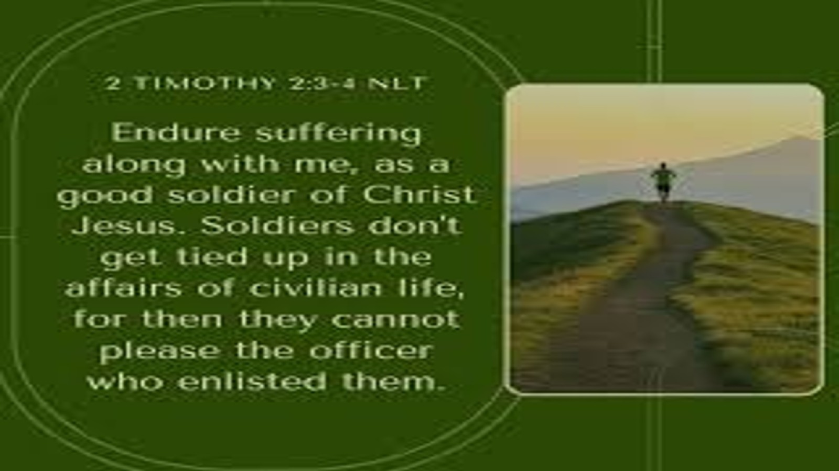

Slide 9
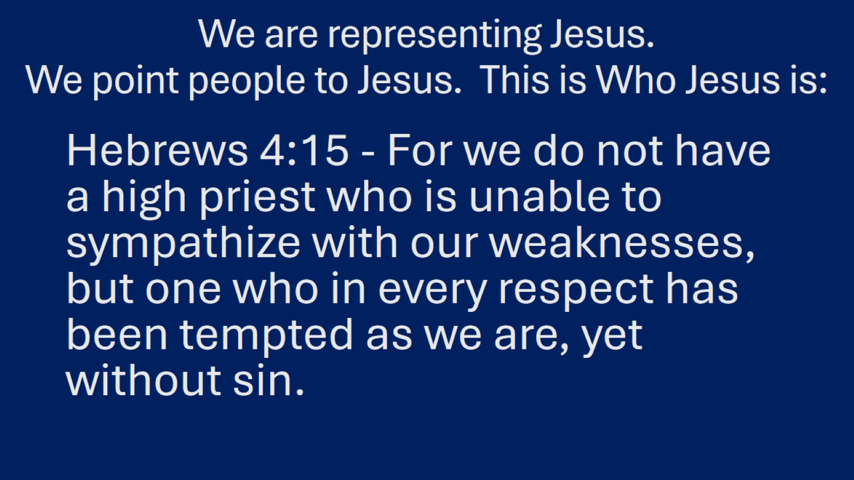
We are representing Jesus.
We point people to Jesus. This is Who Jesus is:

Slide 10
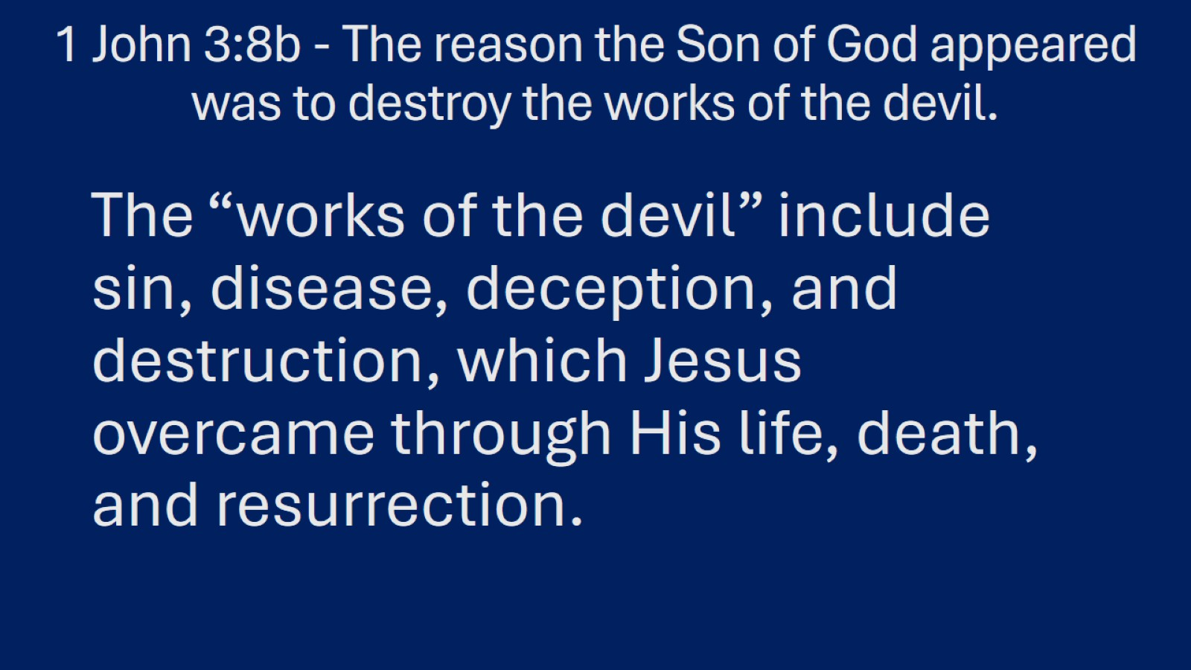
1 John 3:8b - The reason the Son of God appeared was to destroy the works of the devil.

Slide 11
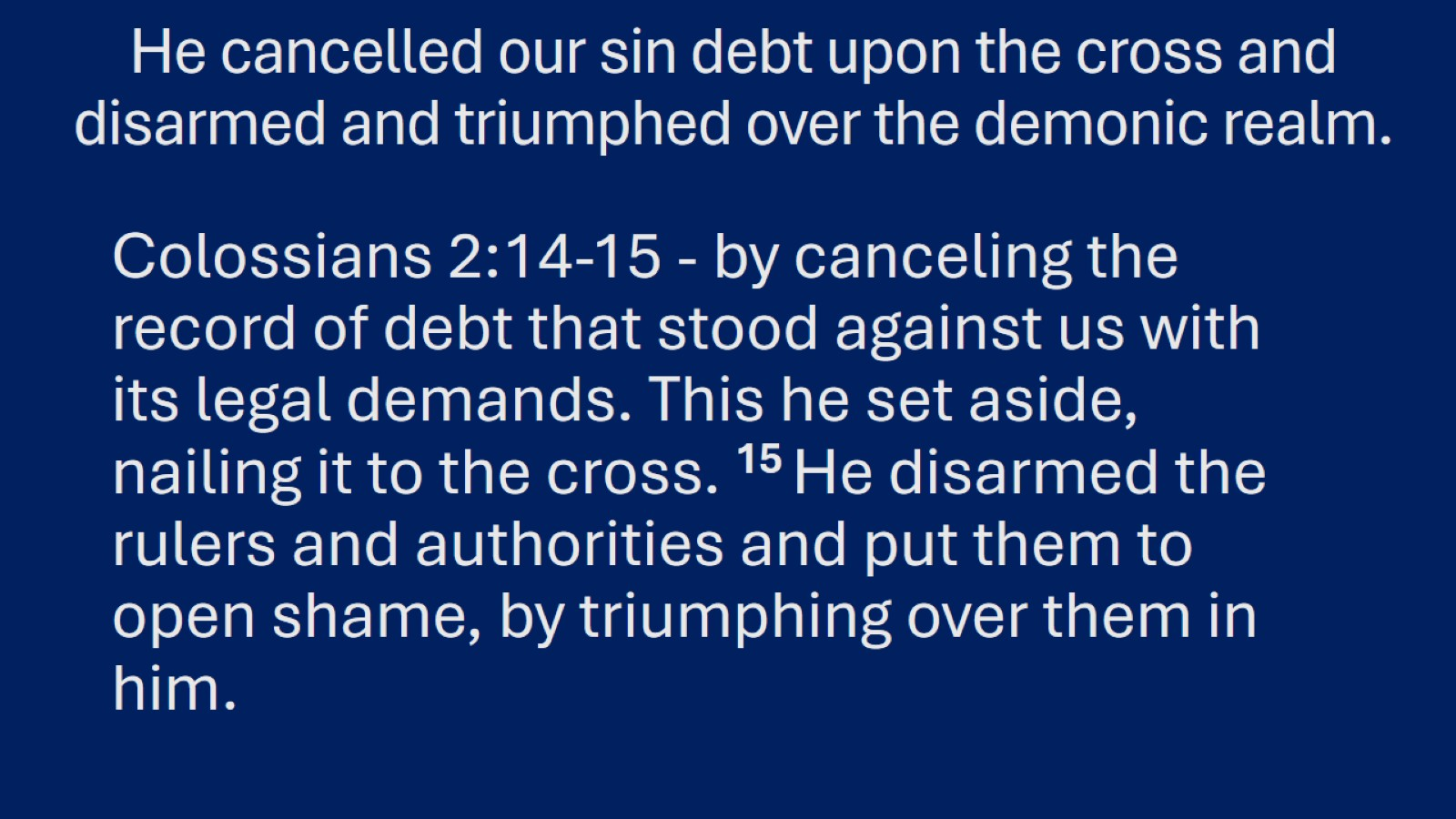
He cancelled our sin debt upon the cross and disarmed and triumphed over the demonic realm.

Slide 12
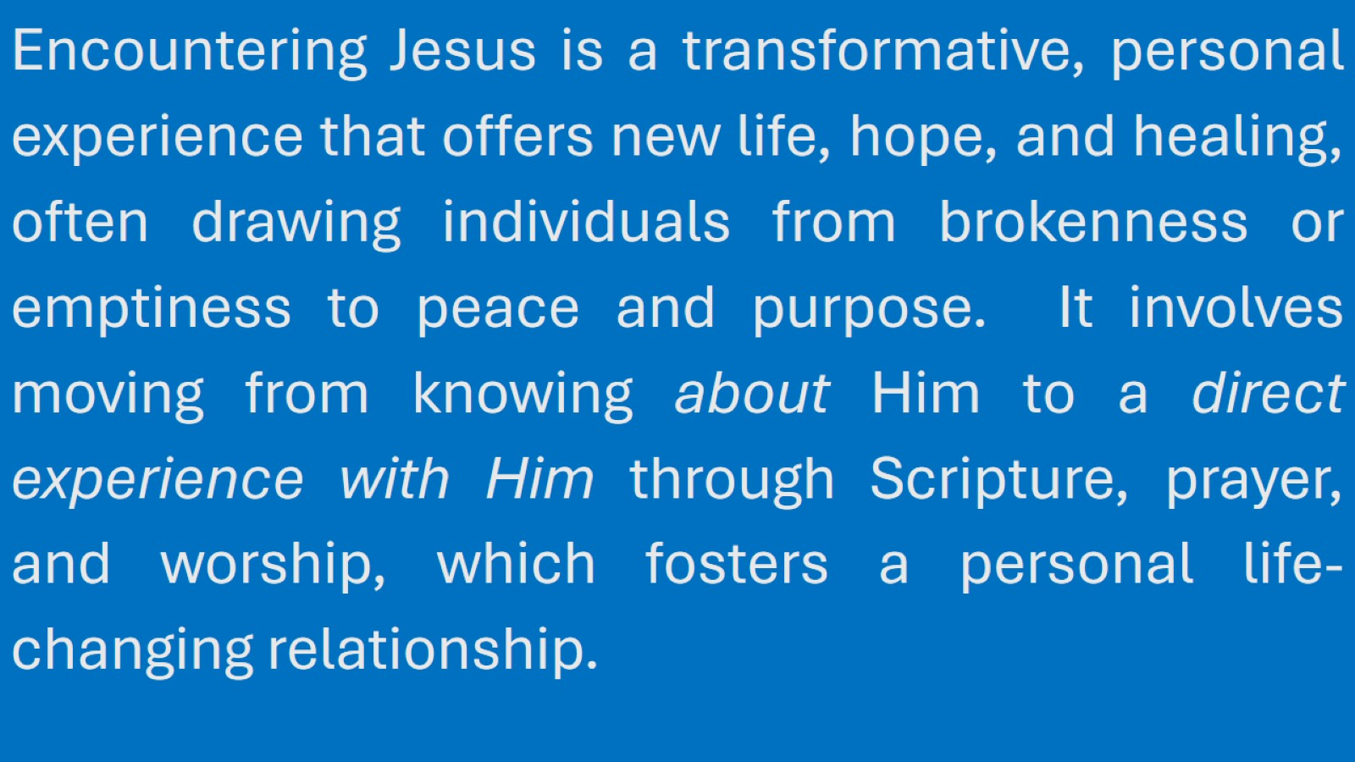

Slide 13
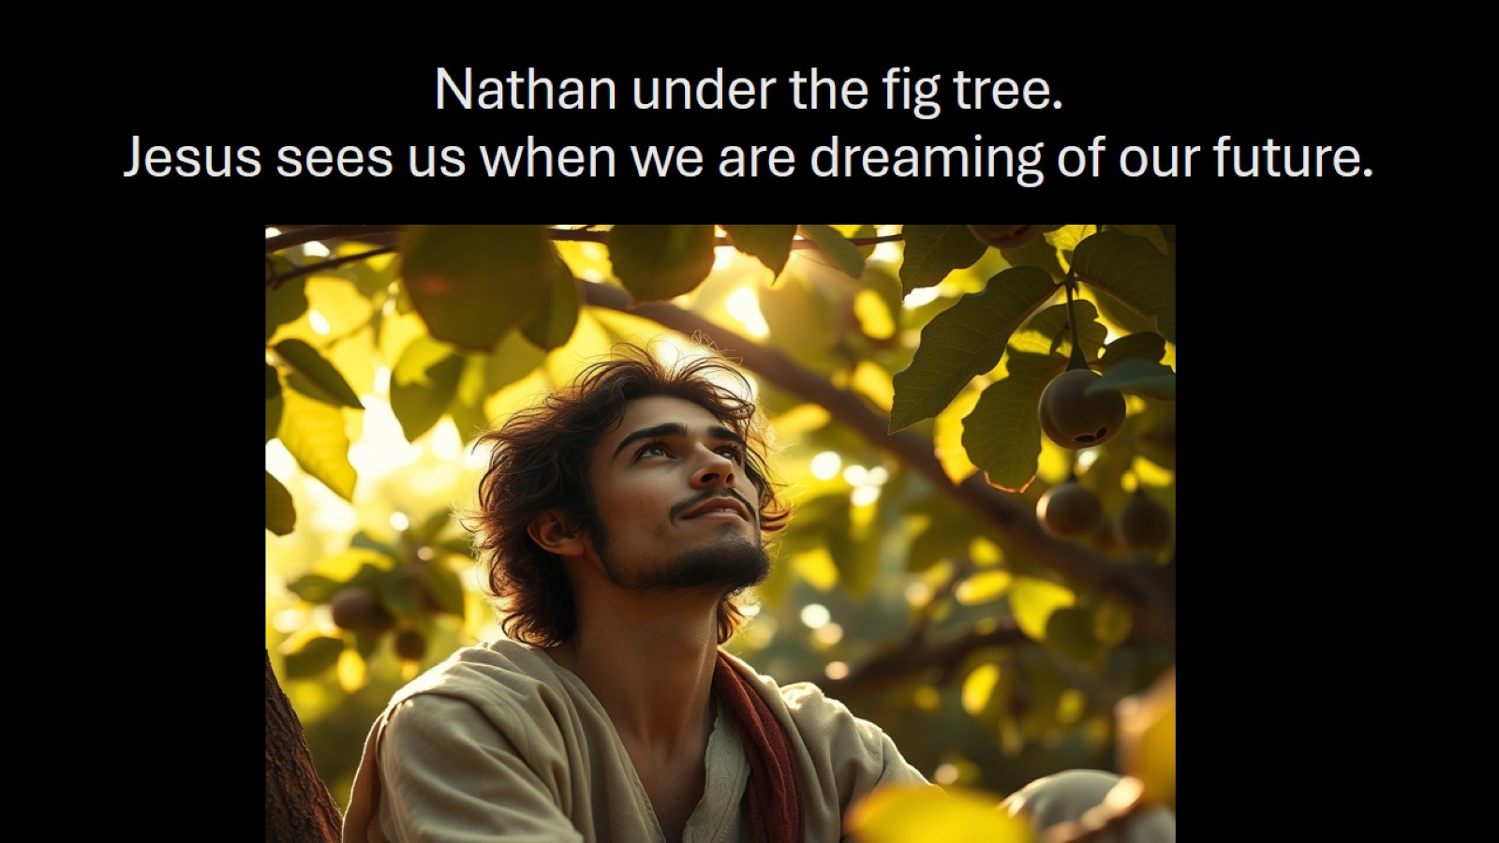
Nathan under the fig tree.
Jesus sees us when we are dreaming of our future.

Slide 14
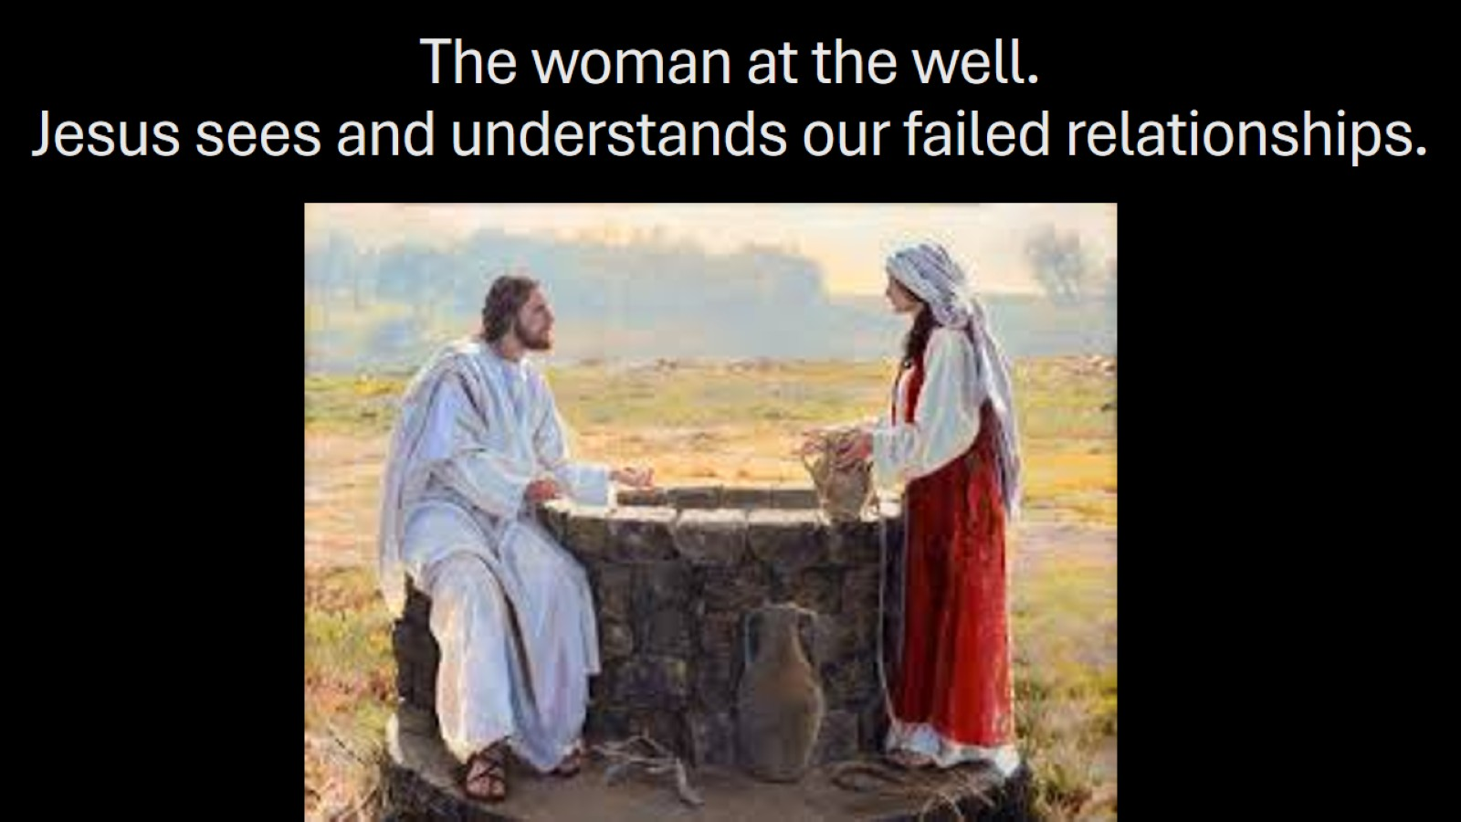
The woman at the well.
Jesus sees and understands our failed relationships.

Slide 15
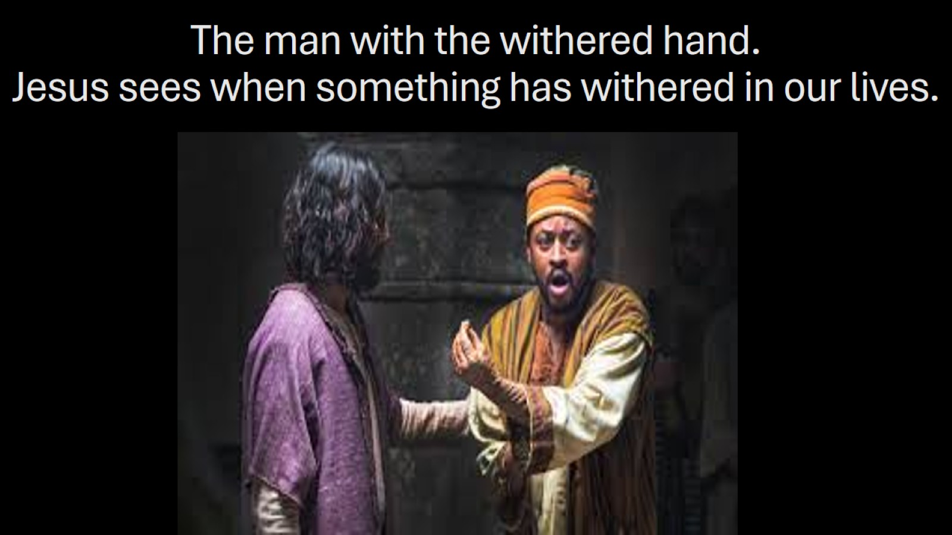
The man with the withered hand.
Jesus sees when something has withered in our lives.

Slide 16
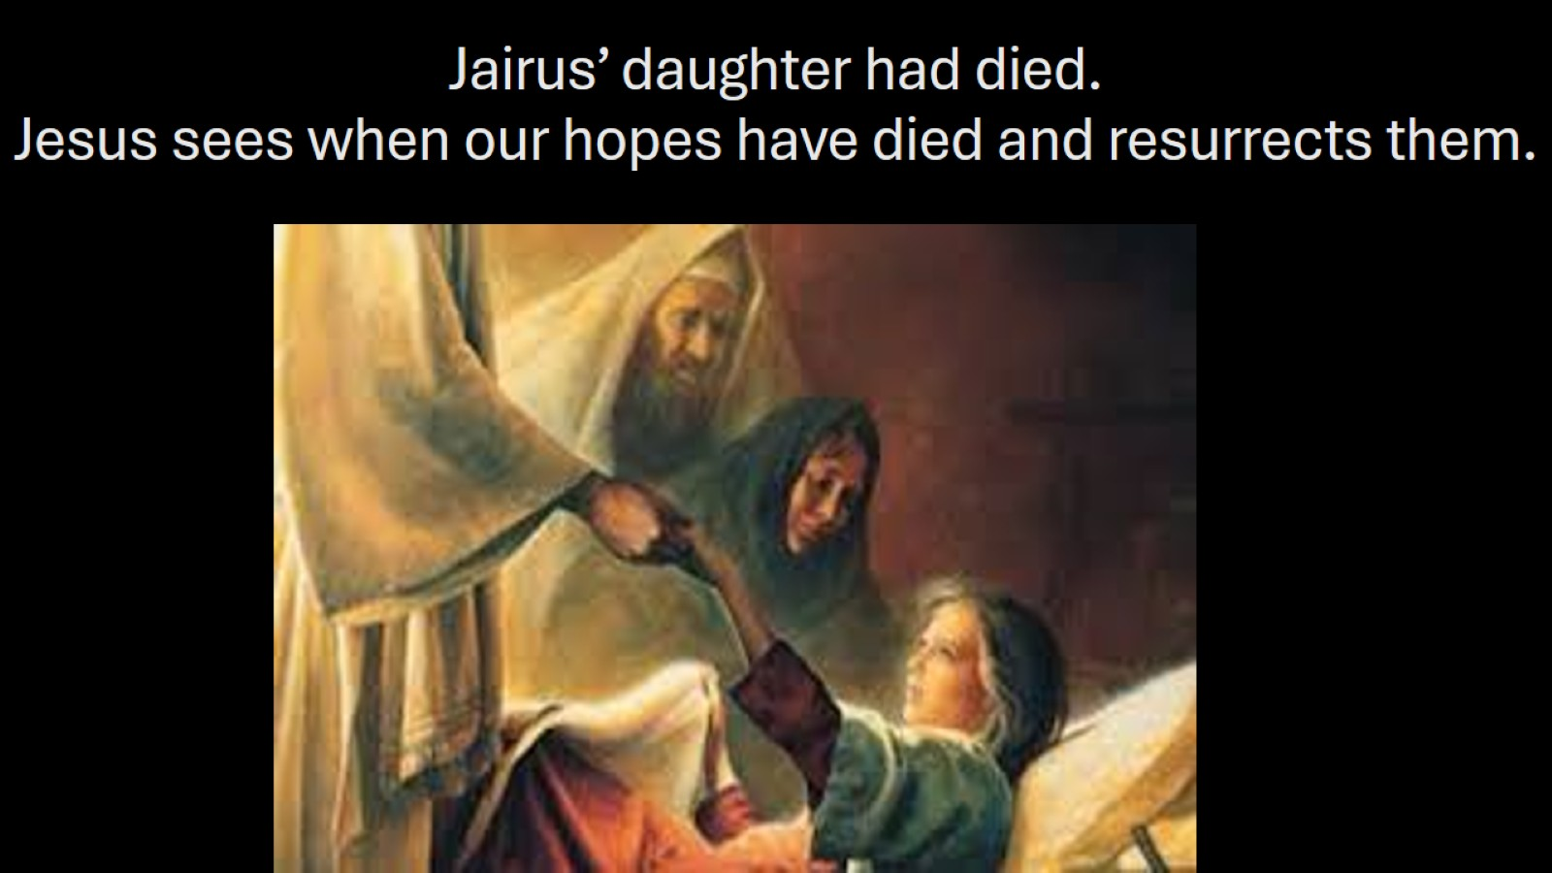
Jairus’ daughter had died.
Jesus sees when our hopes have died and resurrects them.

Slide 17
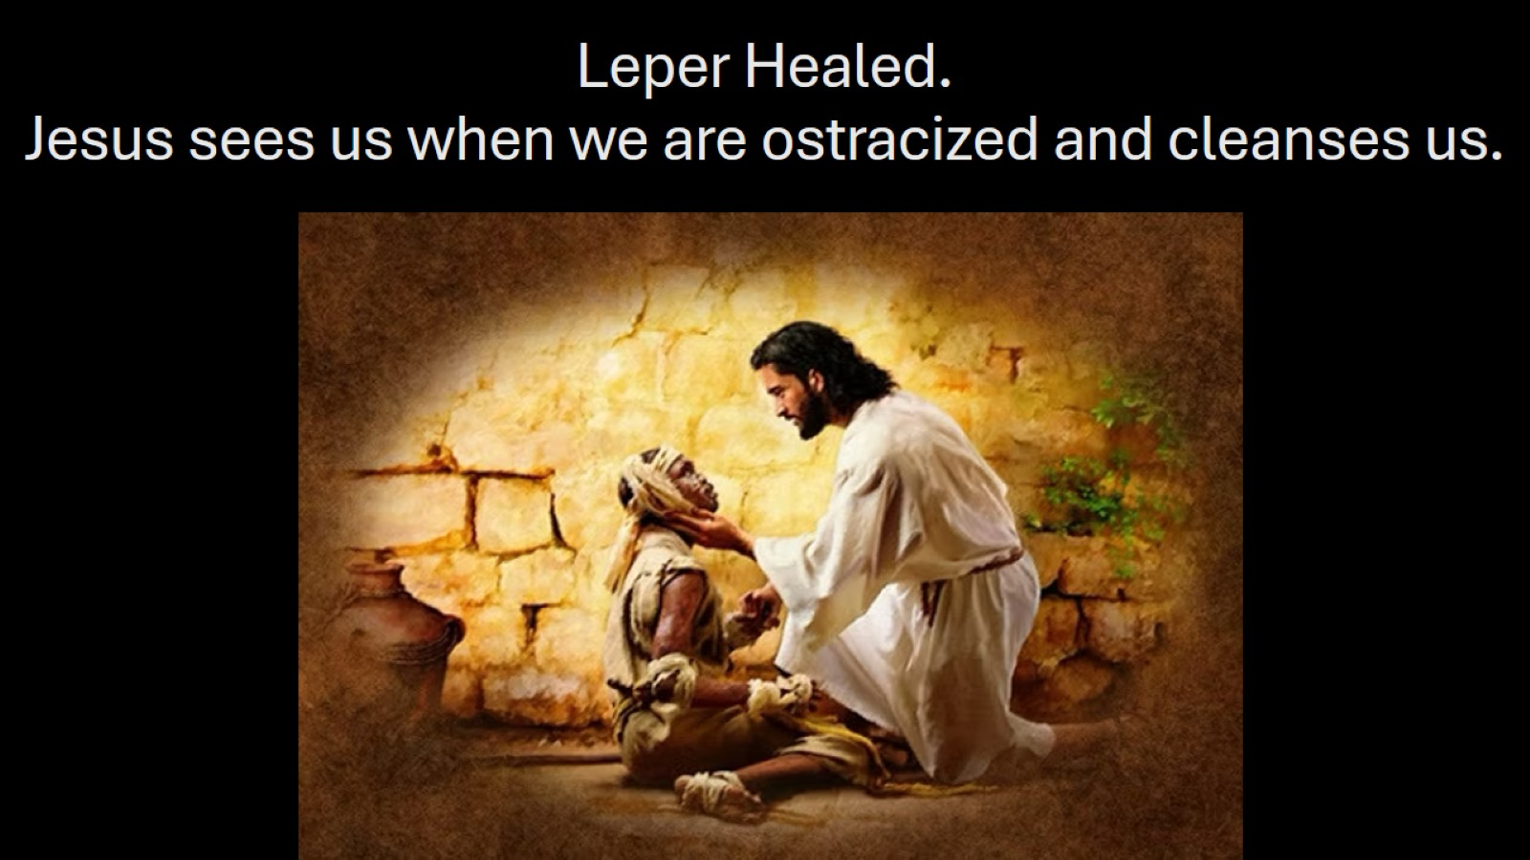
Leper Healed.
Jesus sees us when we are ostracized and cleanses us.

Slide 18
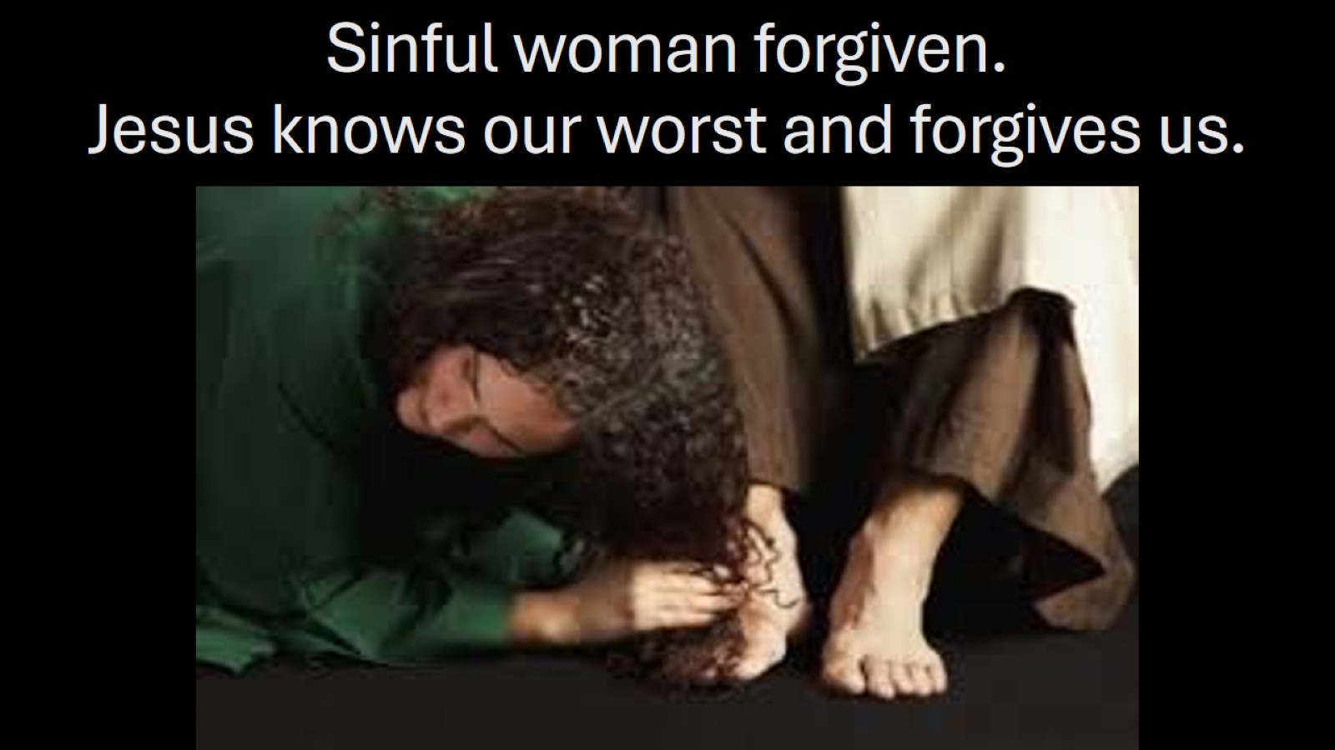
Sinful woman forgiven.
Jesus knows our worst and forgives us.

Slide 19
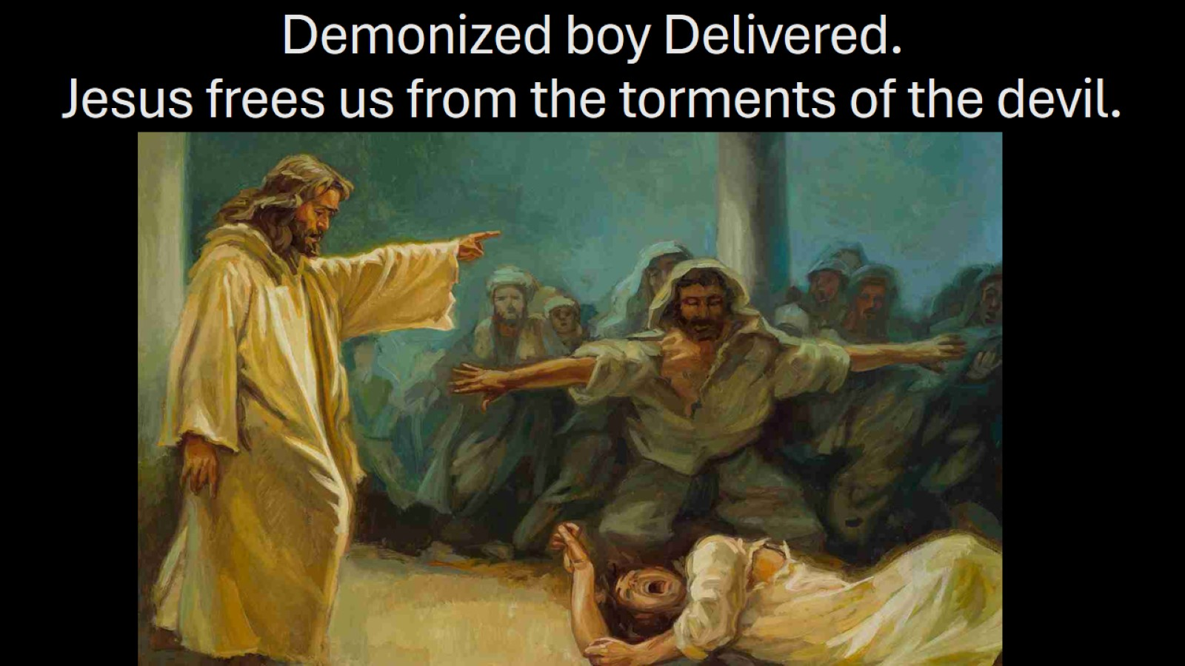
Demonized boy Delivered.
Jesus frees us from the torments of the devil.

Slide 20
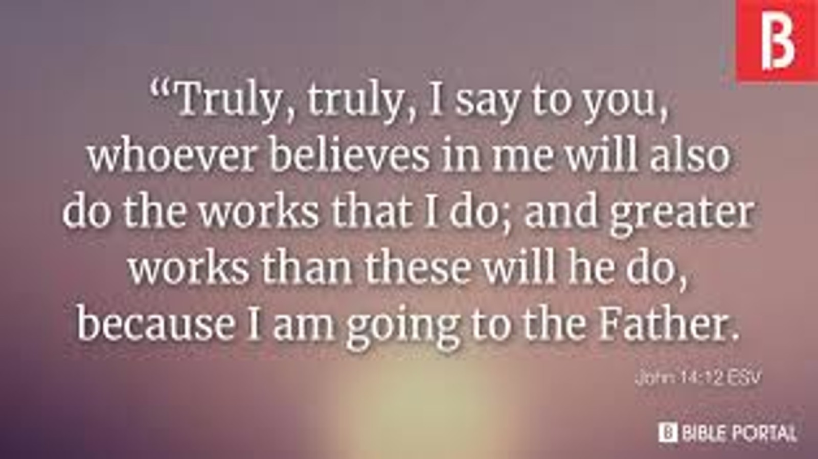

Slide 21
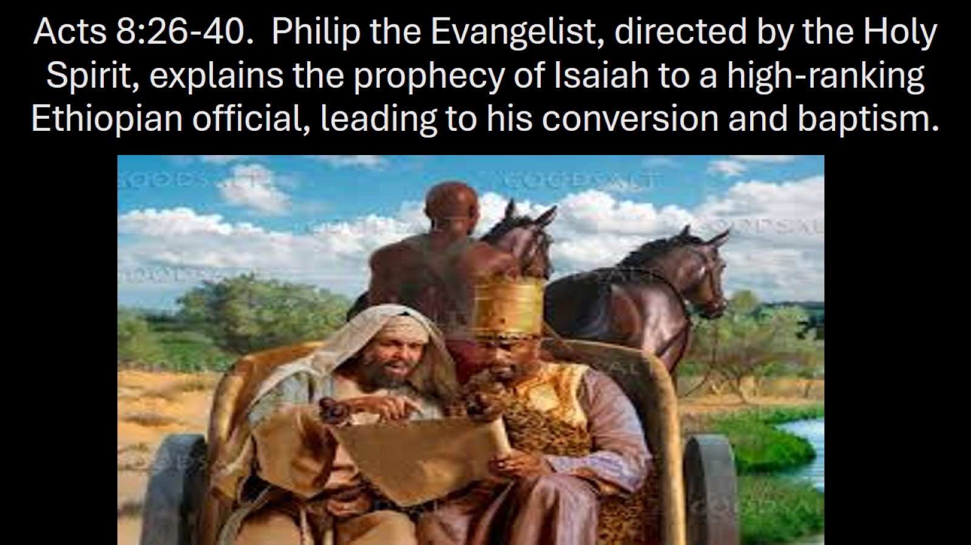
Acts 8:26-40. Philip the Evangelist, directed by the Holy Spirit, explains the prophecy of Isaiah to a high-ranking Ethiopian official, leading to his conversion and baptism.

Slide 22
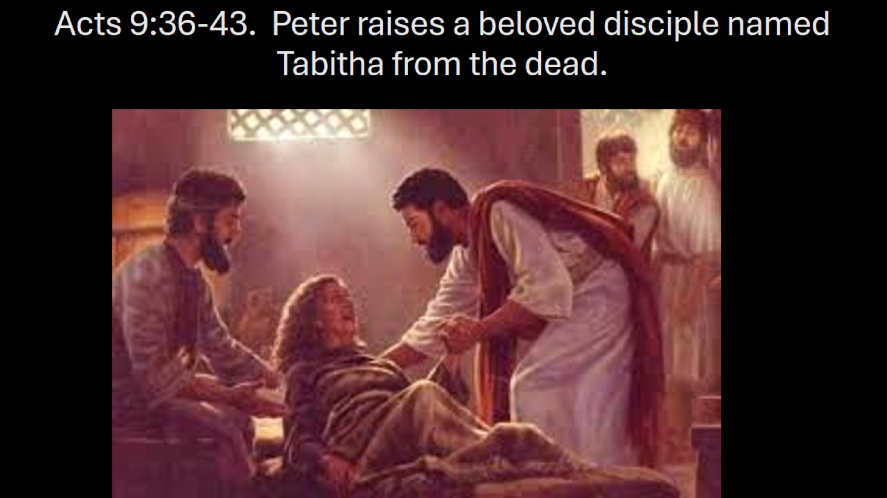
Acts 9:36-43. Peter raises a beloved disciple named Tabitha from the dead.

Slide 23
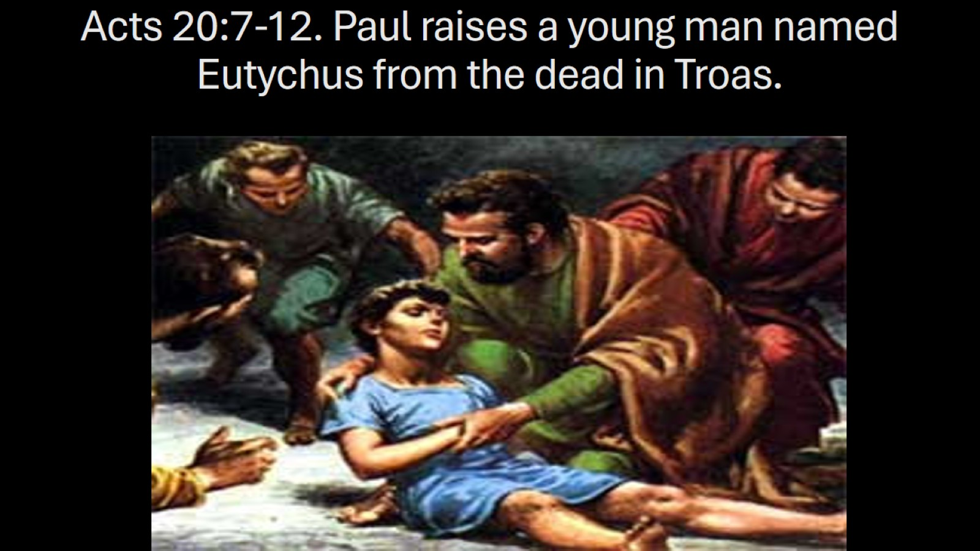
Acts 20:7-12. Paul raises a young man named Eutychus from the dead in Troas.

Slide 24
